Slide 1
THG Simulations
Project update
Week 5
18/08/2023
David Amorim

Slide 2
Simulations
An extensive round of parameter scans was carried out, involving over 5000 simulation runs
considered Ar, Ne, Kr, Xe, He, N2, and N2O
beam powers: 75mW, 150mW, 200mW, 300mW, and 400mW
pressures: 0.1bar to 5.1bar in 0.1bar increments
density profiles: gradient and COMSOL
The scan outputs consisted of:
total UV energy & efficiency
UV pulse duration
UV output spectrum
Position in the cell of the UV energy peak
Caveats: the simulations used the ADK ionisation model instead of PPT; at the time of writing, the simulations have not yet finished!

Slide 3
Overview
Compare the two density models
Compare the profiles themselves
Show general results of pressure scan comparisons
In-depth case study
Compare different gases
Identify “conditions of interest” (combinations of pressure, beam power, and gas that result in >100nJ sub-2fs UV pulses)

Slide 4
I. COMSOL V. GRADIENT

Slide 5
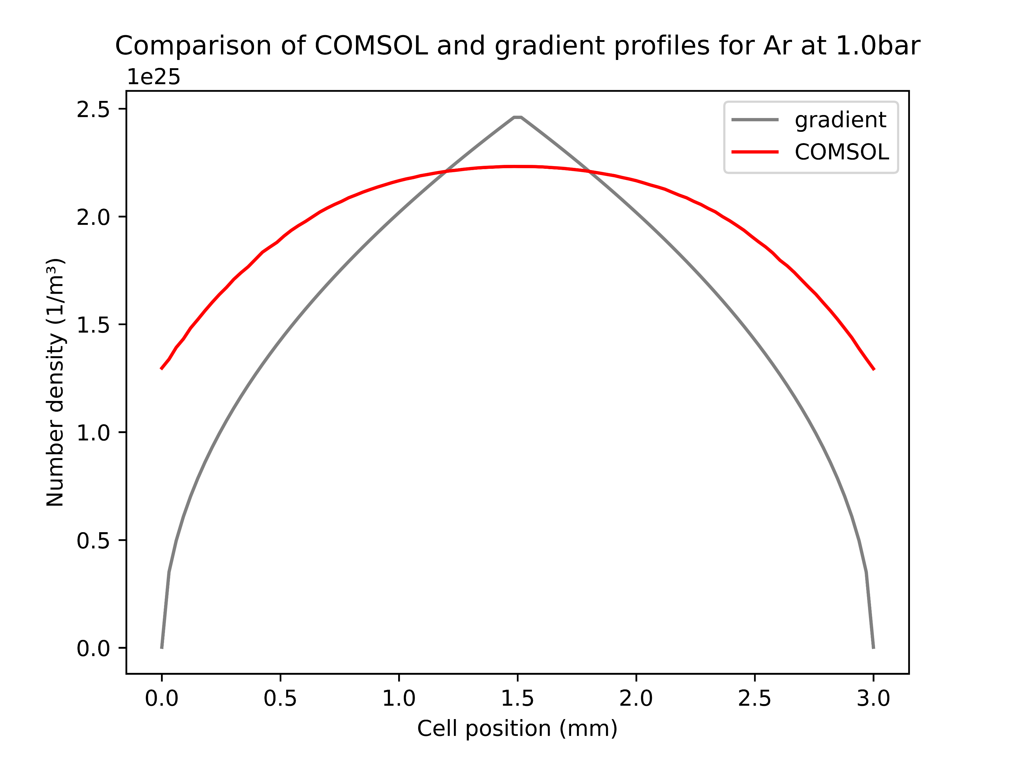
The density profiles
Gradient profile has a higher peak and steeper drop-off than COMSOL
This difference is (qualitatively) unchanged when varying the pressure
Most importantly but not shown here: COMSOL also includes the region outside the cell (3.5cm on either side)
Overall, fairly good agreement of the two models within the cell

Slide 6
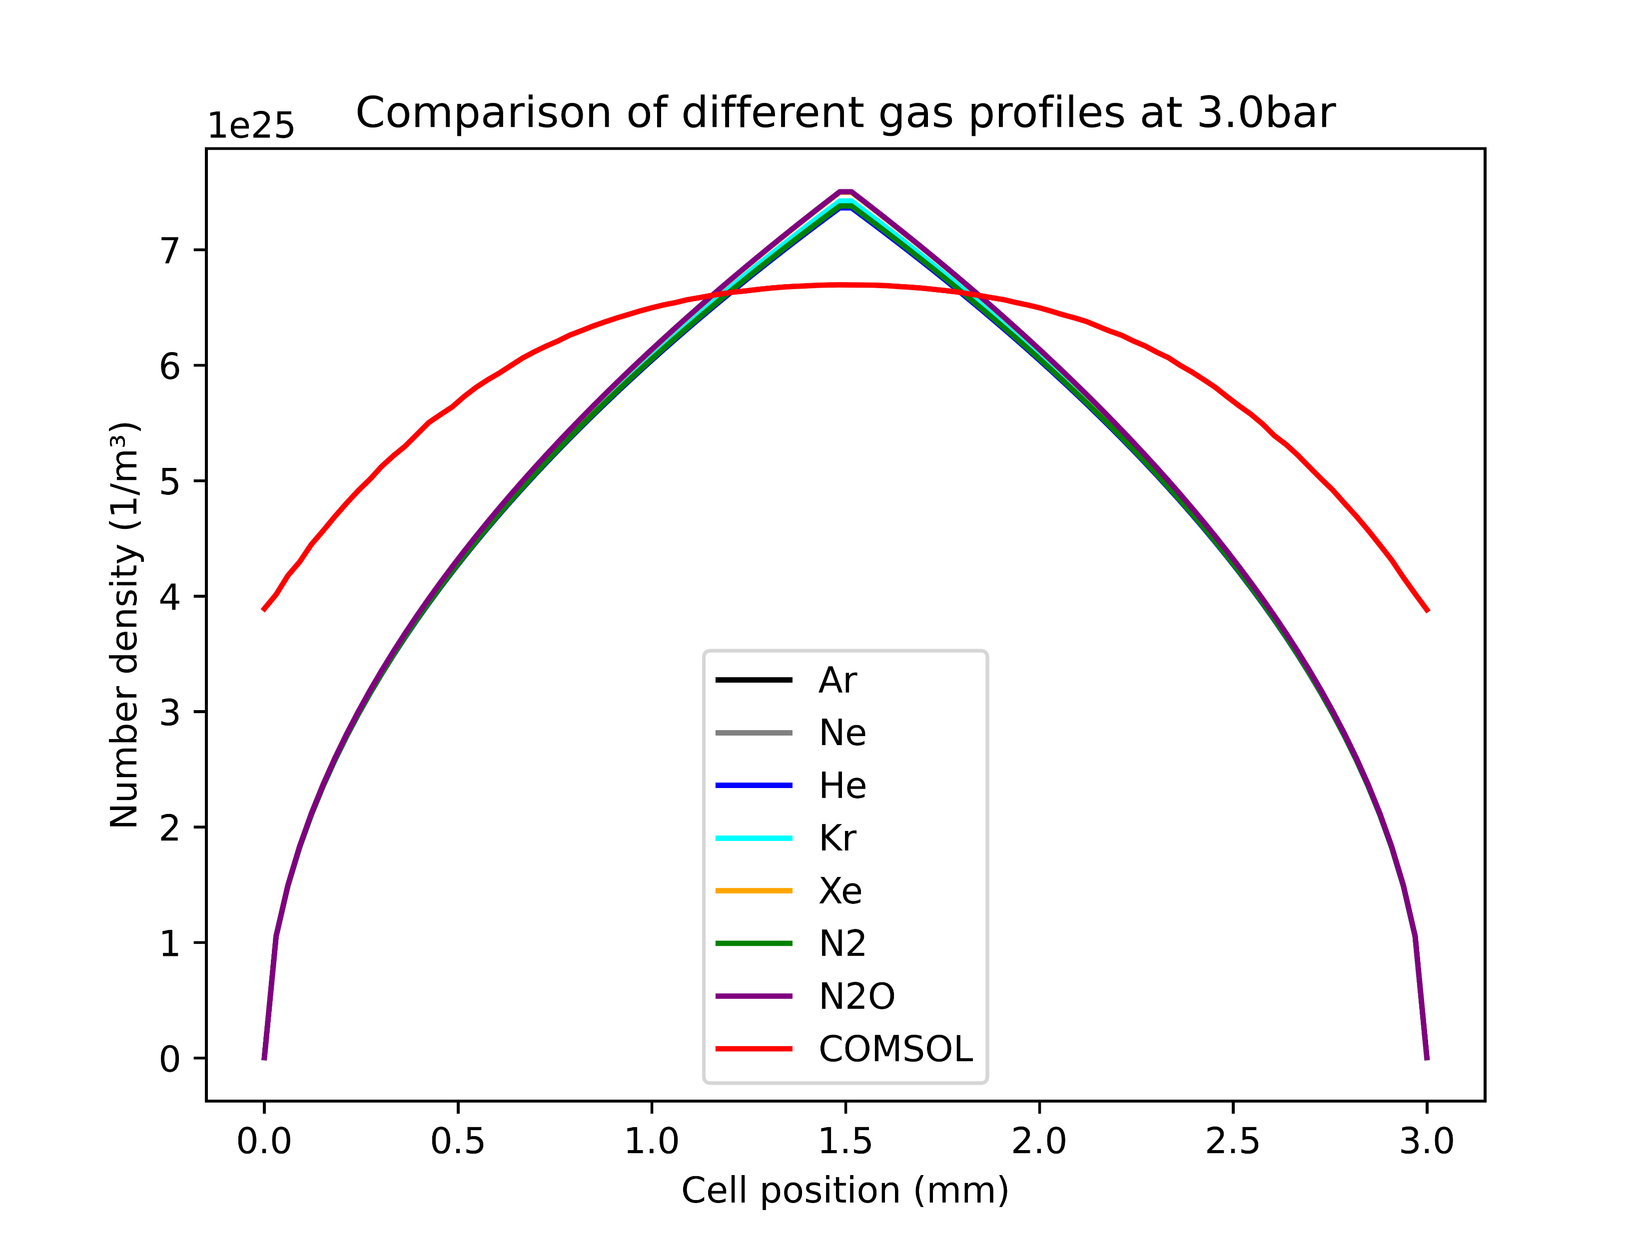
The density profiles
The COMSOL simulations are only based on Argon
However, at the given pressures there is barely any difference in the density profiles of various gases
Thus, the COMSOL model was also used for the other gases in the parameter scans
Note: the COMSOL data used here was not generated with the improved high-Mach model!

Slide 7
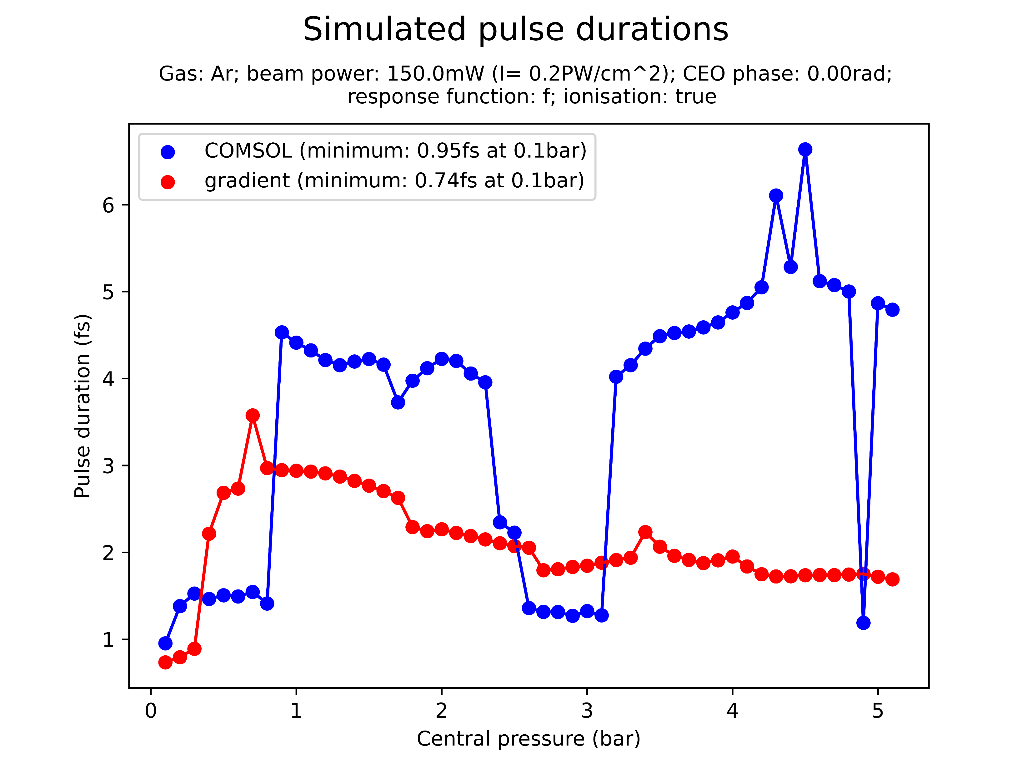
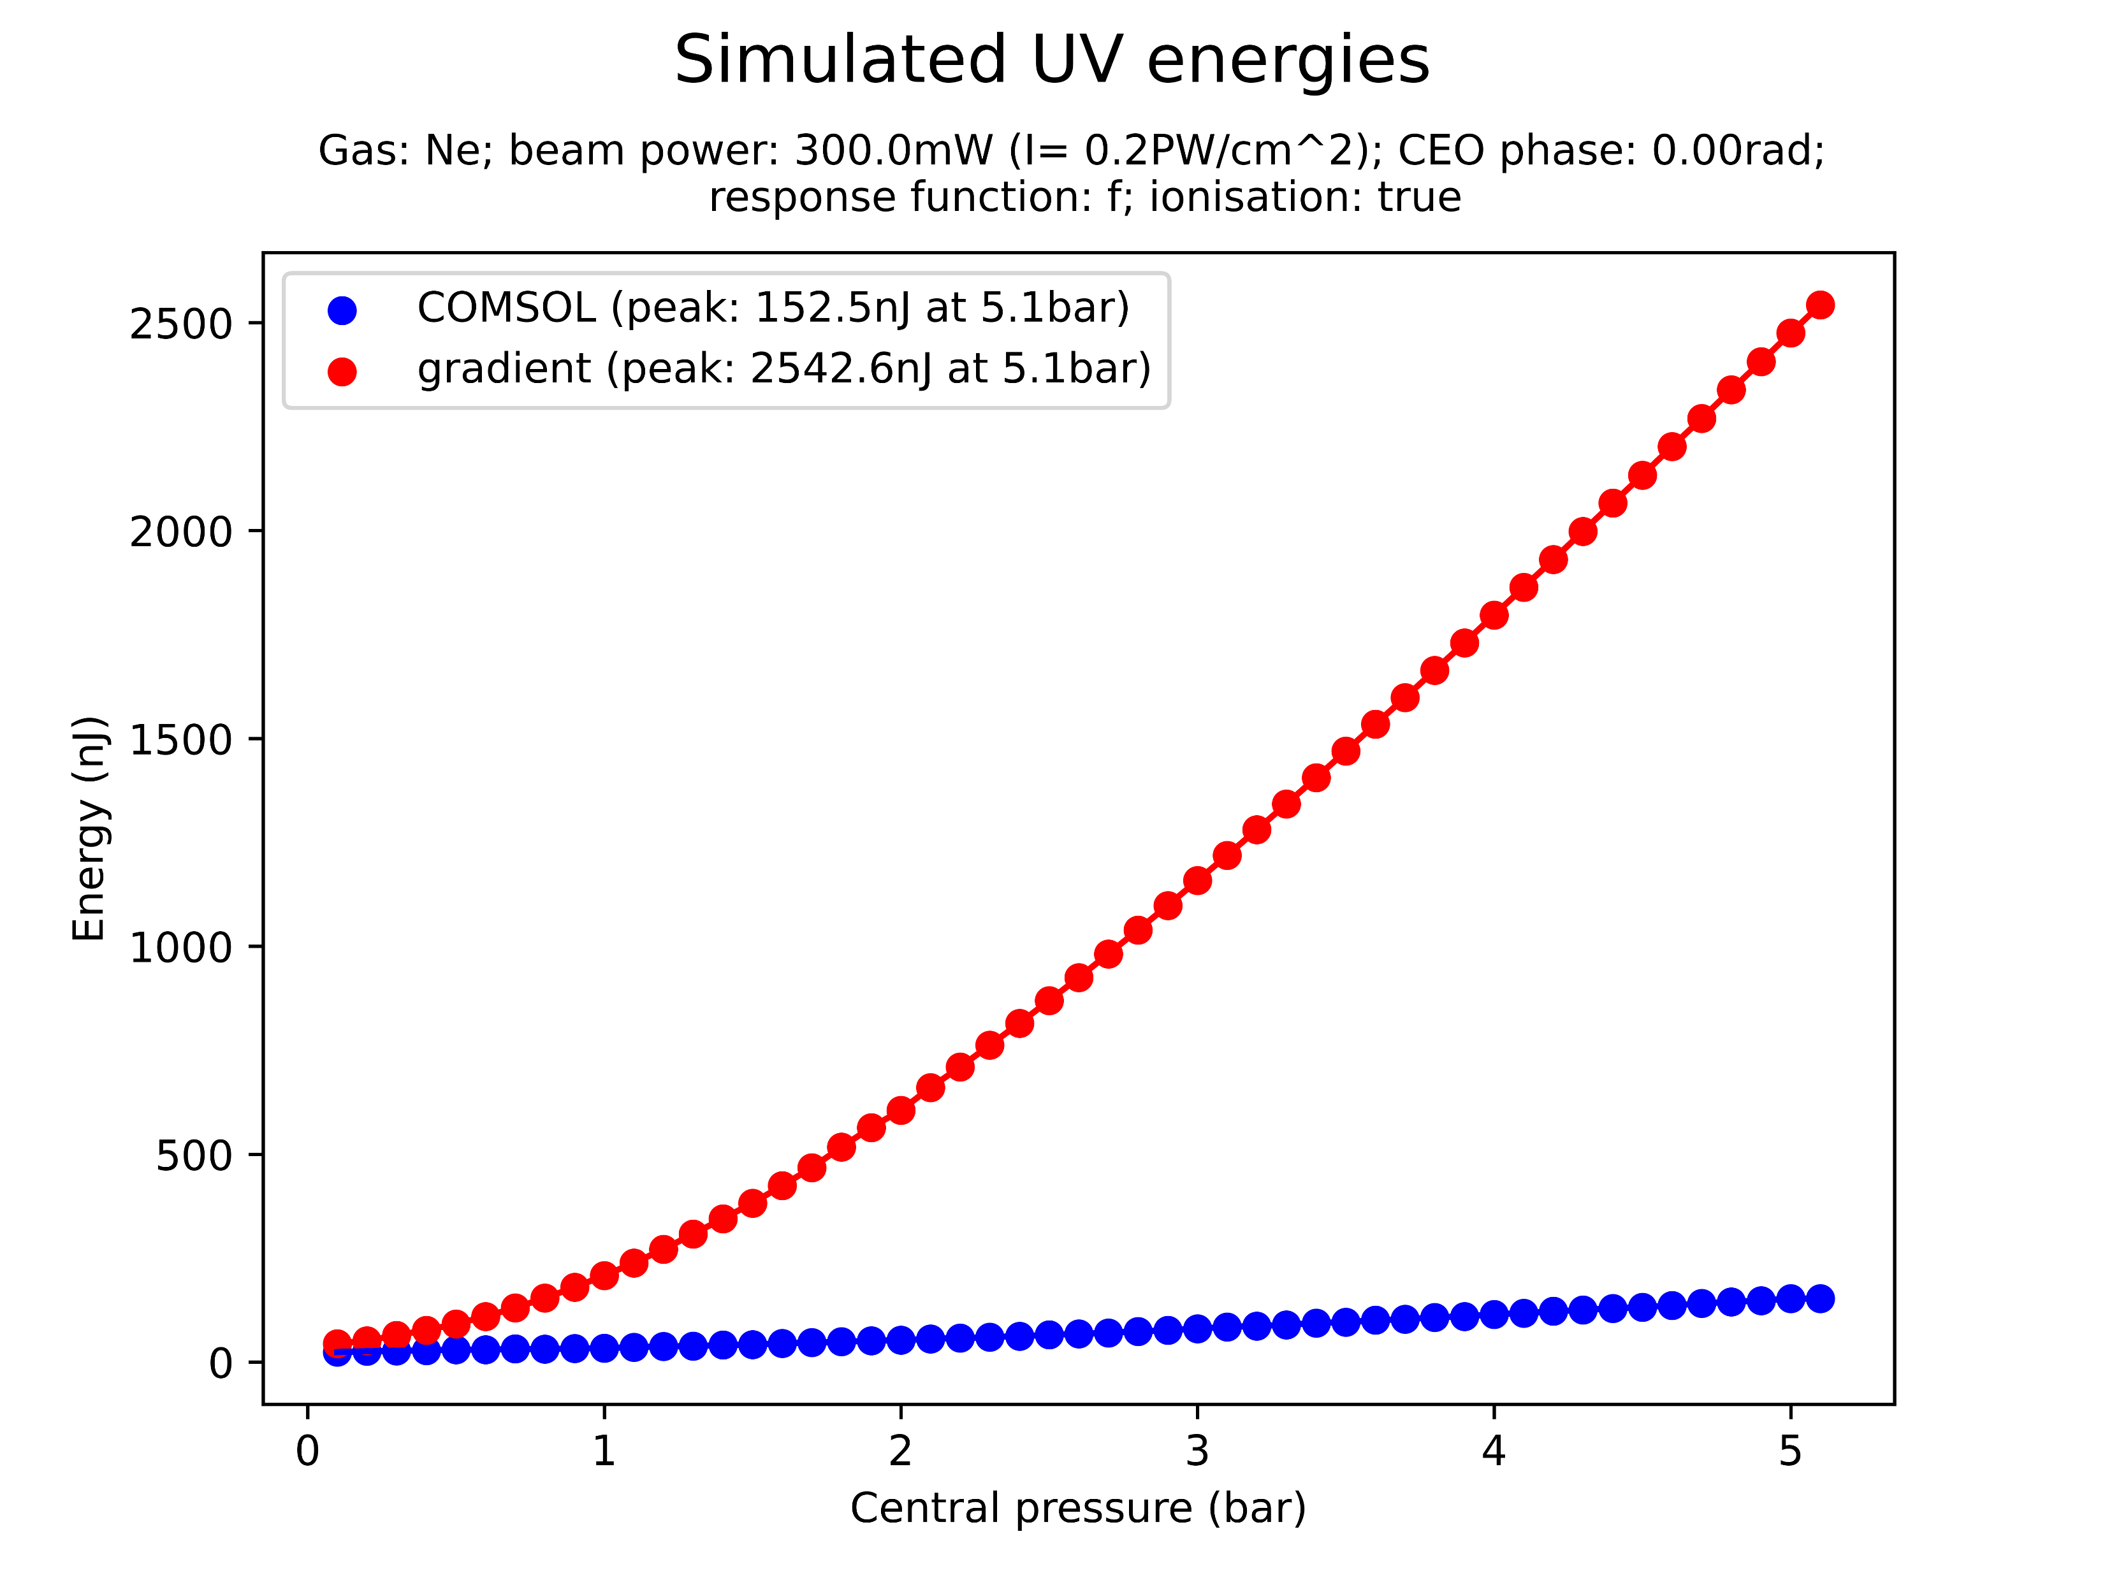
Pressure scan comparisons
The COMSOL and gradient models were compared in a variety of pressure scans
Across all beam powers and pressures, COMSOL predicts a significantly lower UV energy output
Exception: 300mW N2O!
There is also generally disagreement between the simulated pulse duration, although without a clear pattern
Note: FWHM pulse durations are used, which are sensitive to pulse shape and can hence be misleading!
Note: the plots above are random examples and not related

Slide 8
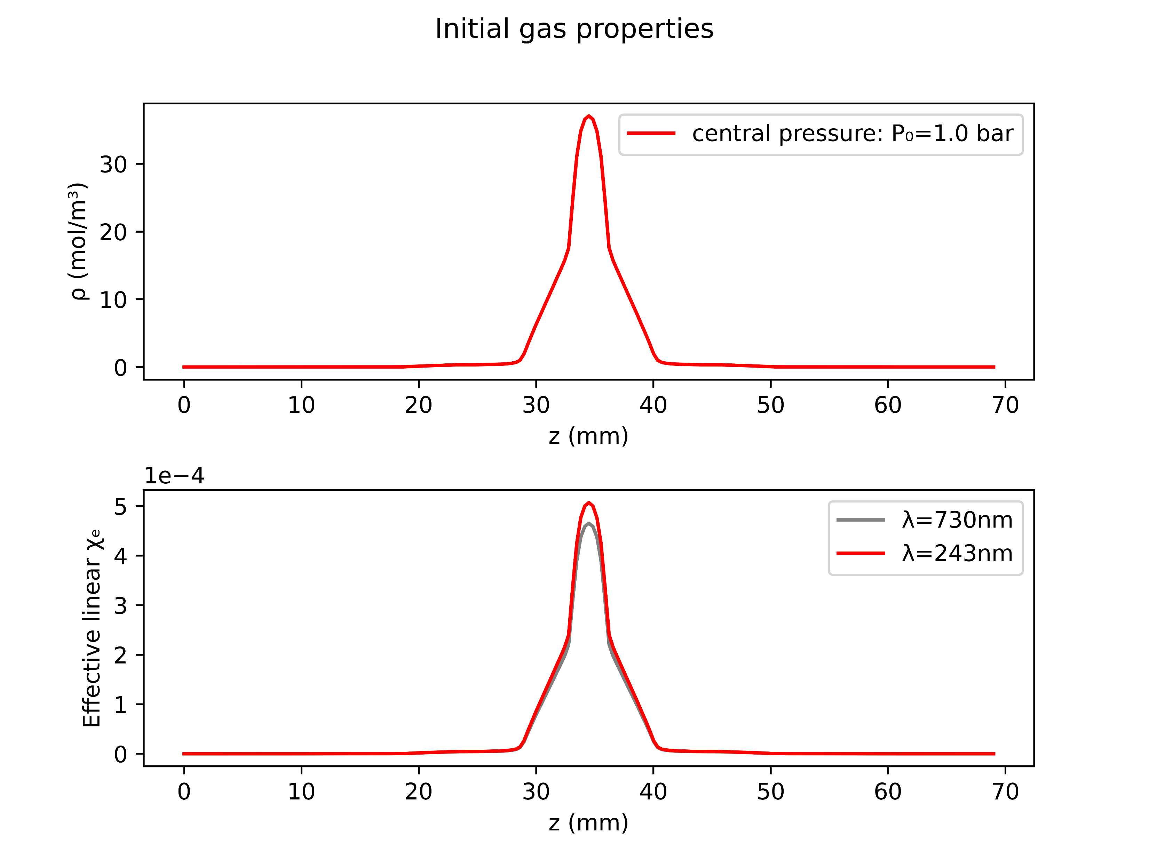
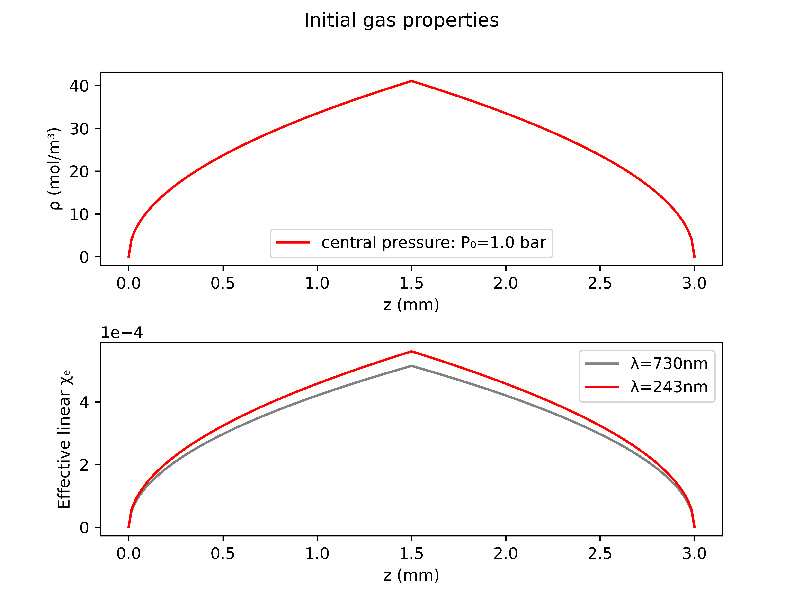
Case study: Argon at 1.0bar with 150mW
COMSOL
gradient

Slide 9
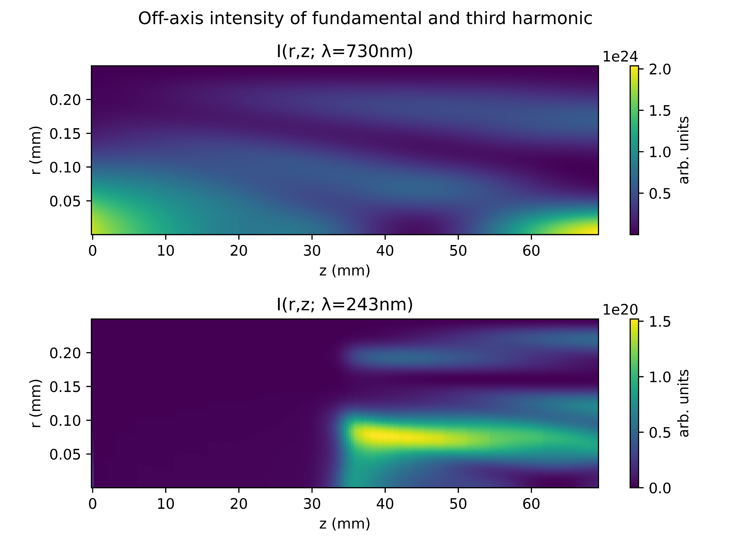
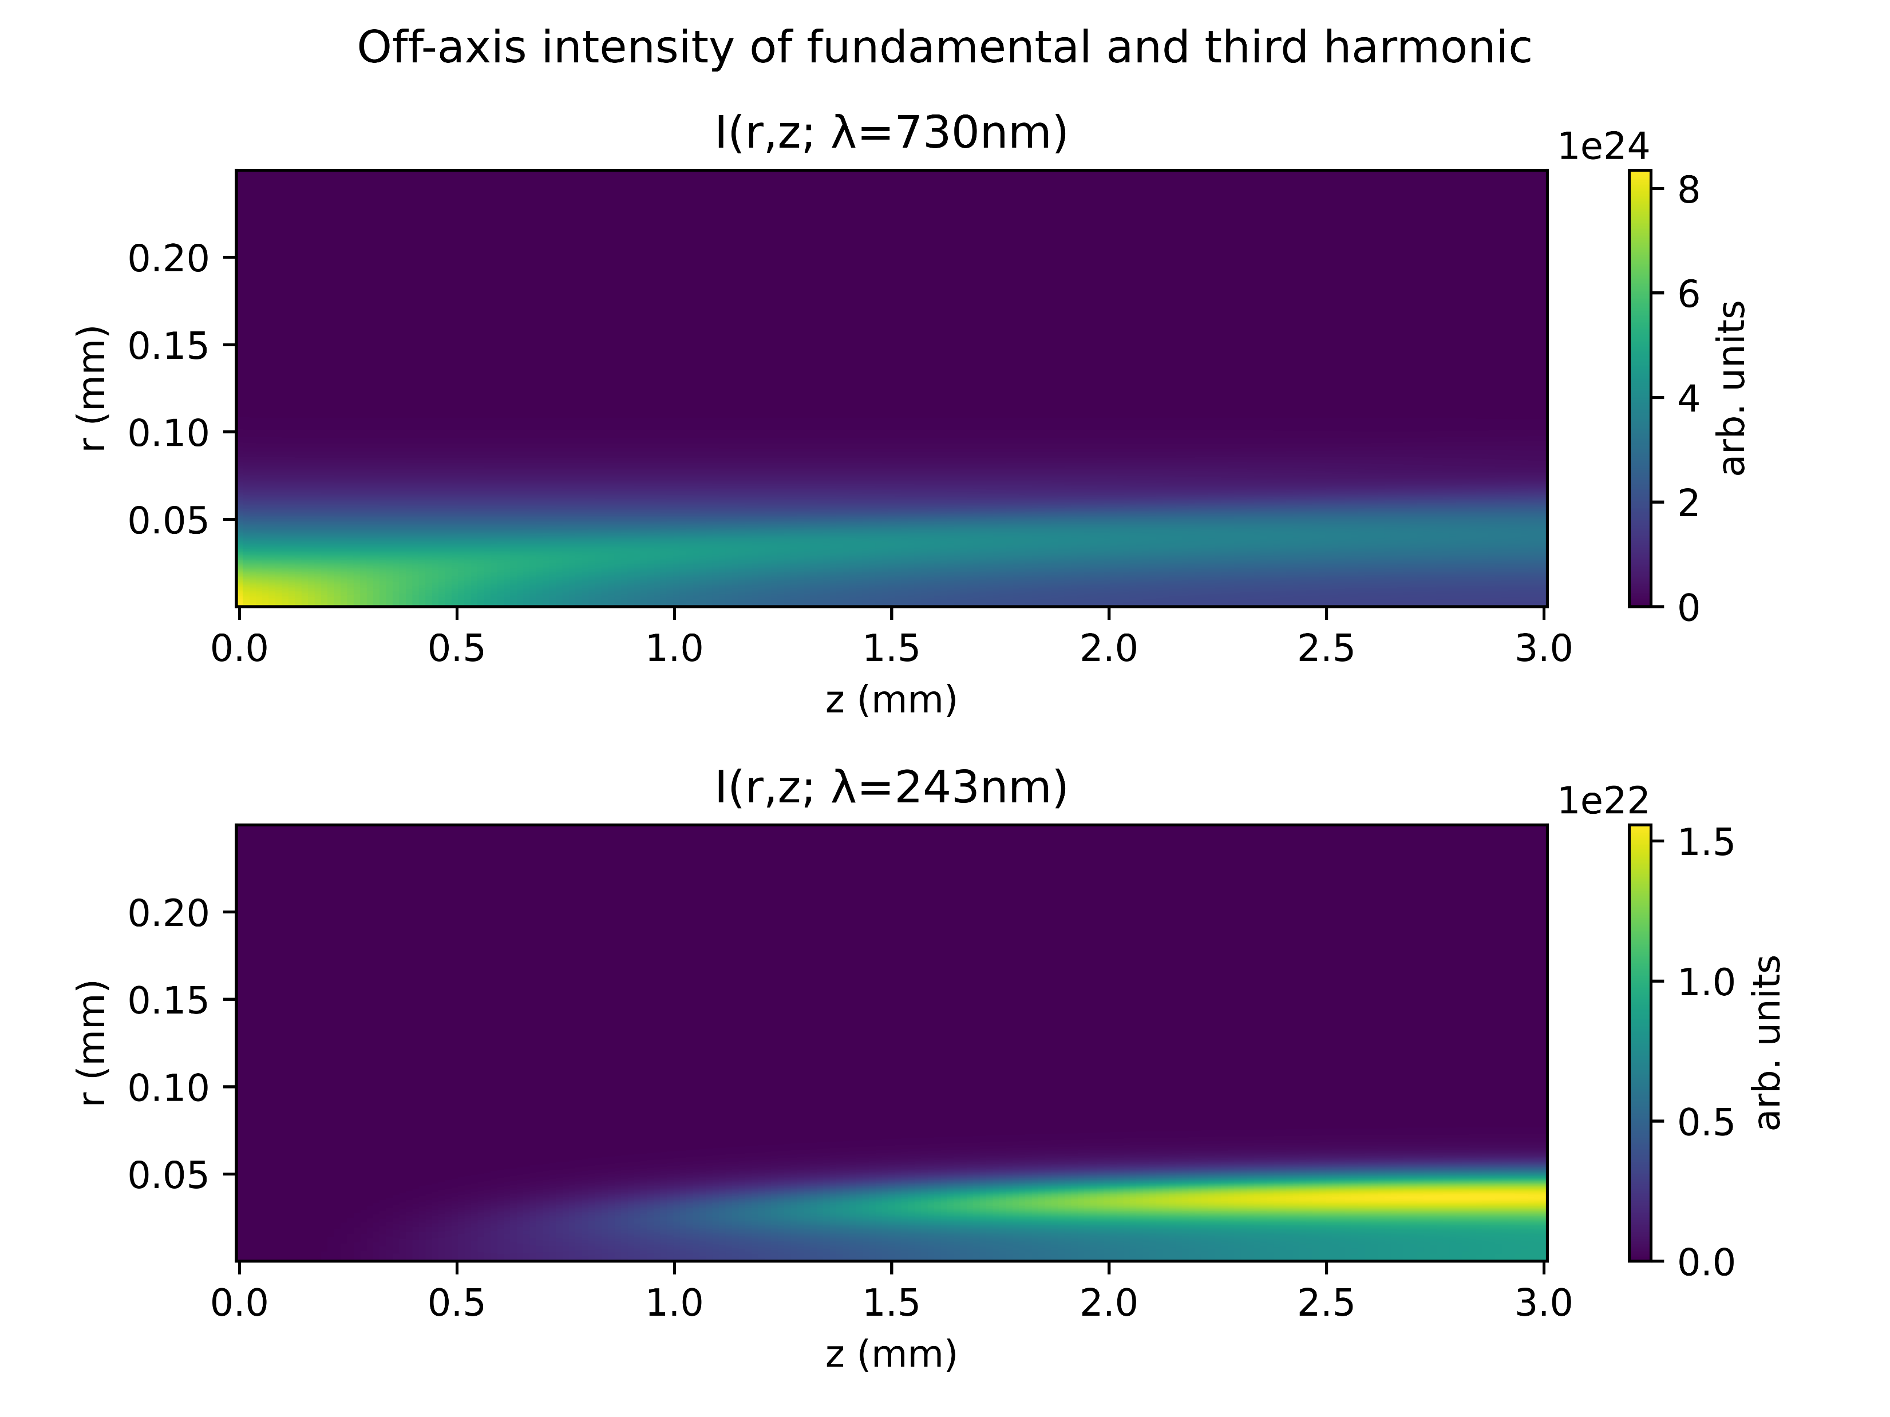
Case study: Argon at 1.0bar with 150mW
COMSOL
gradient

Slide 10
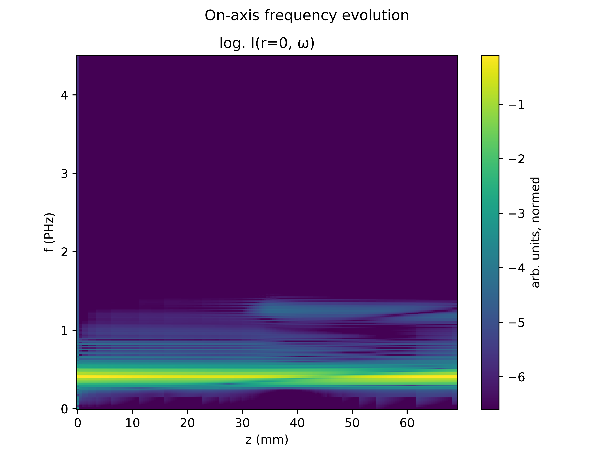
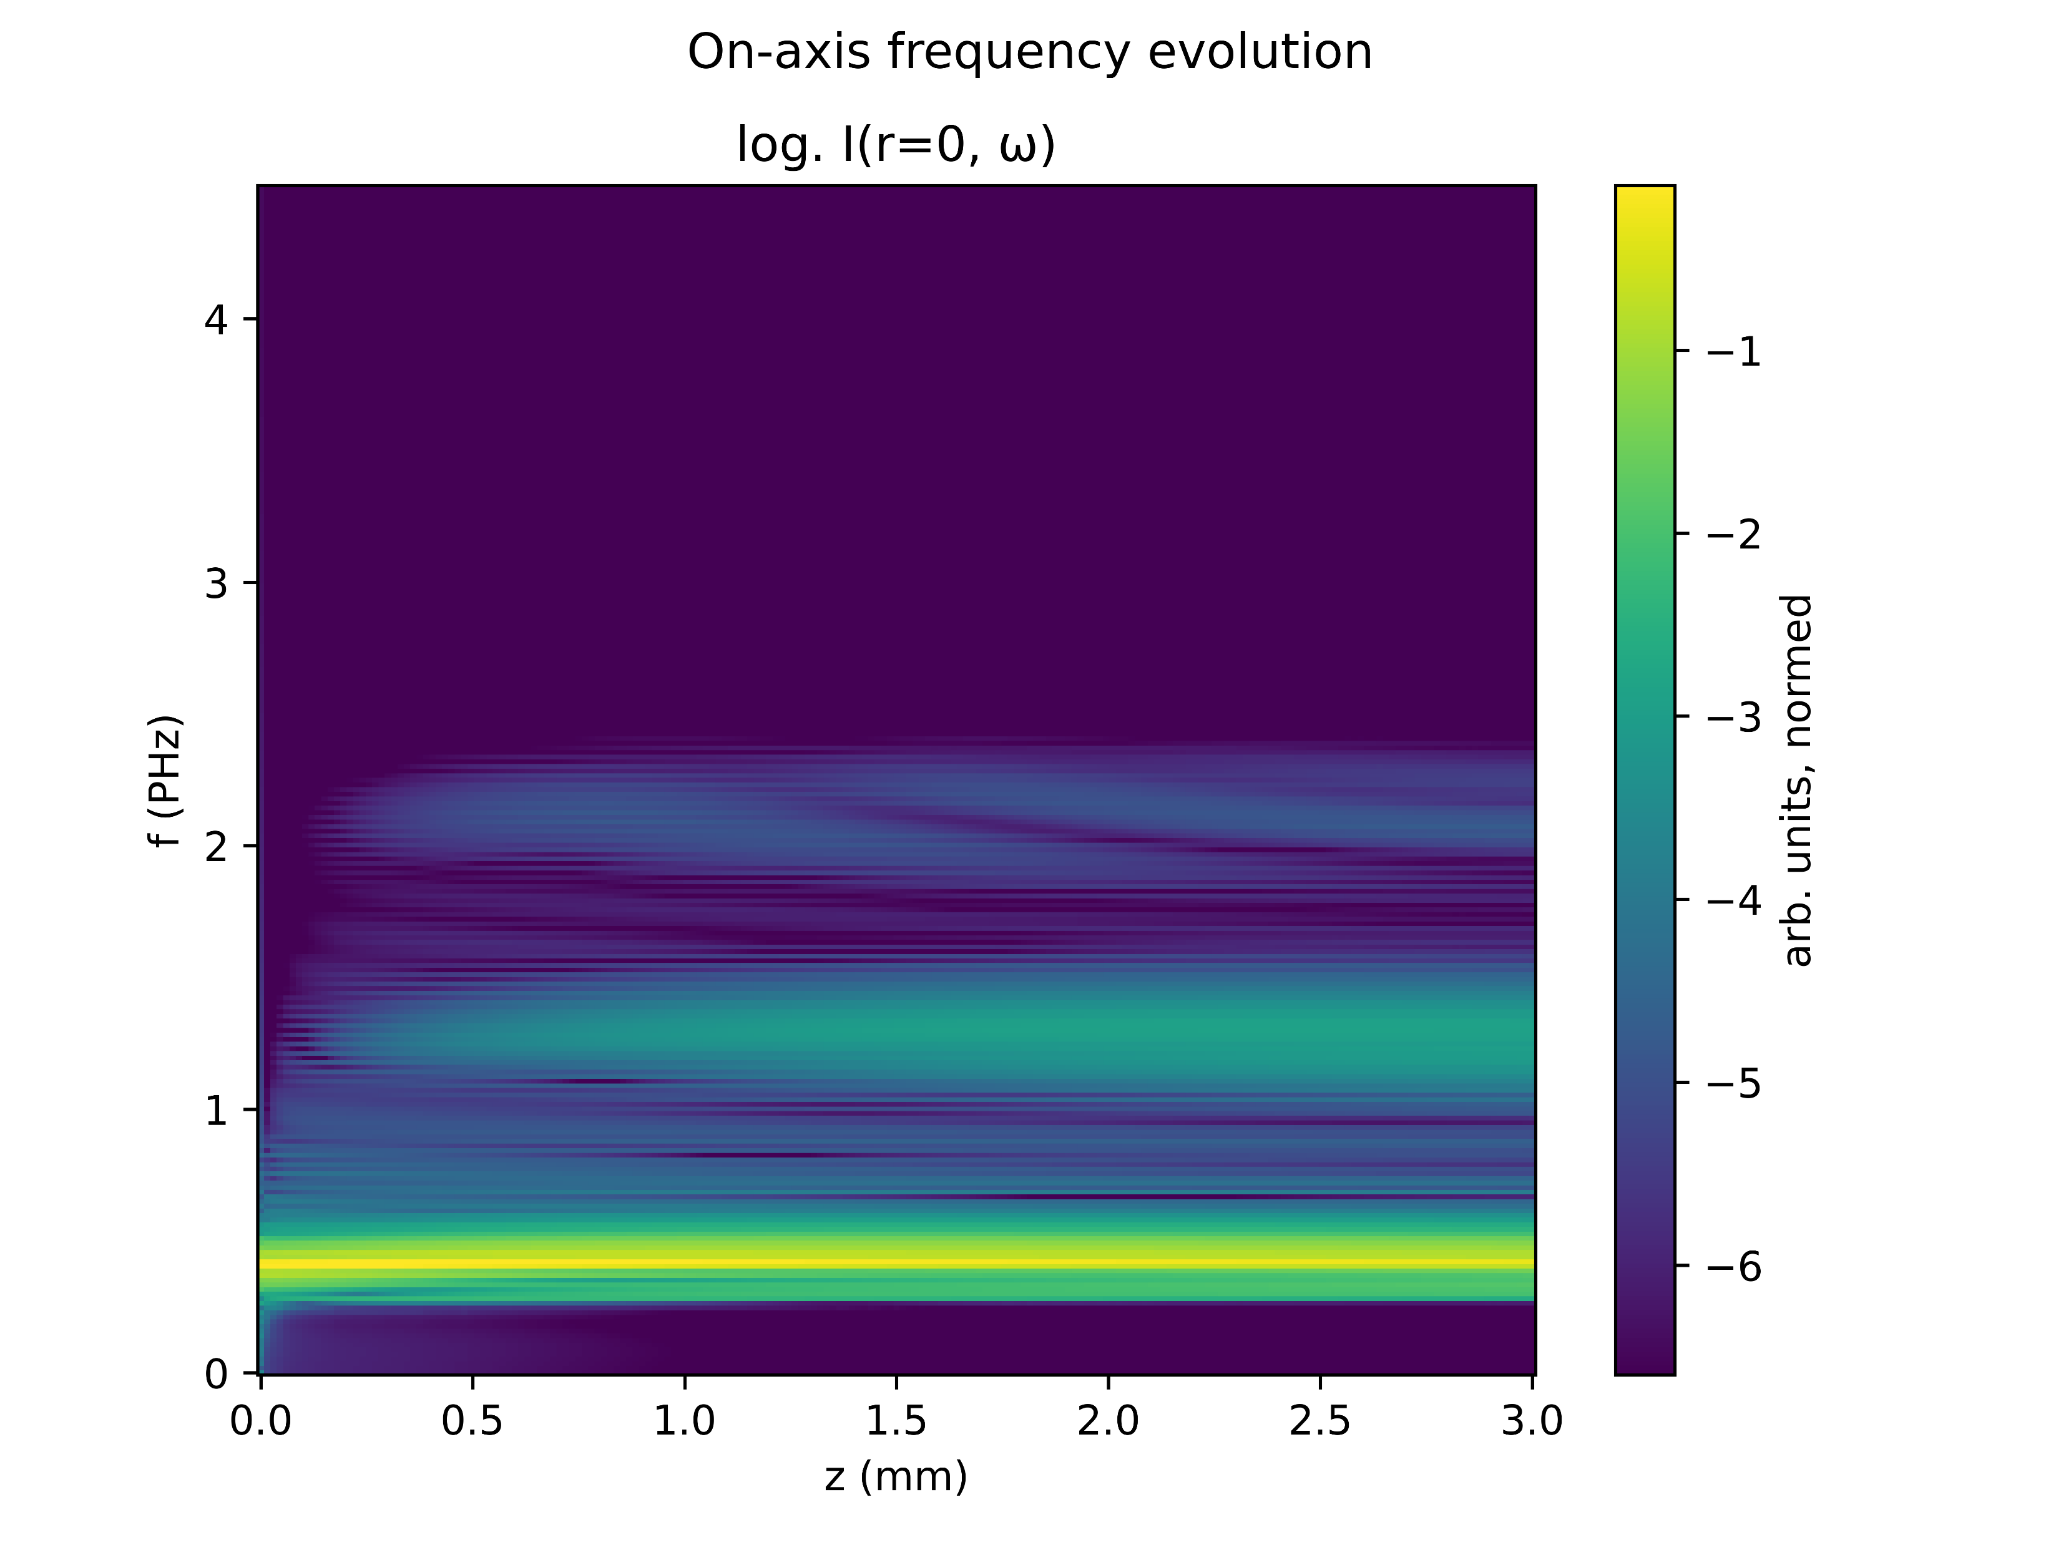
Case study : Argon at 1.0bar with 150mW
COMSOL
gradient

Slide 11
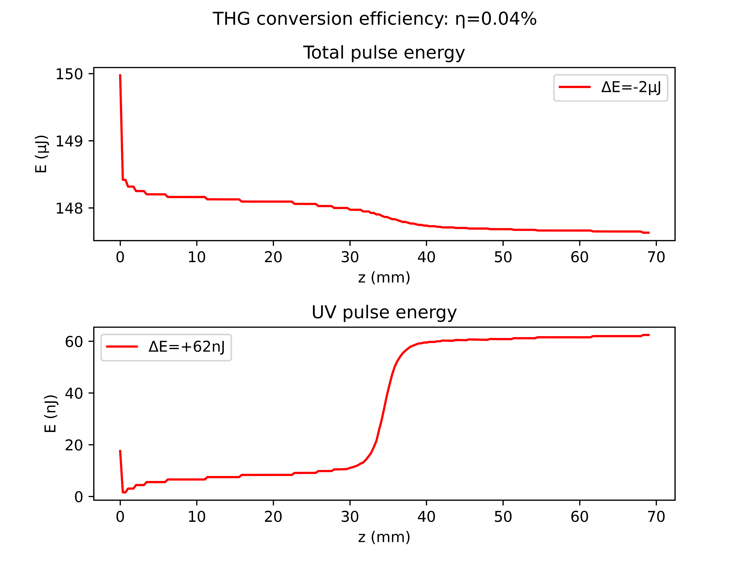
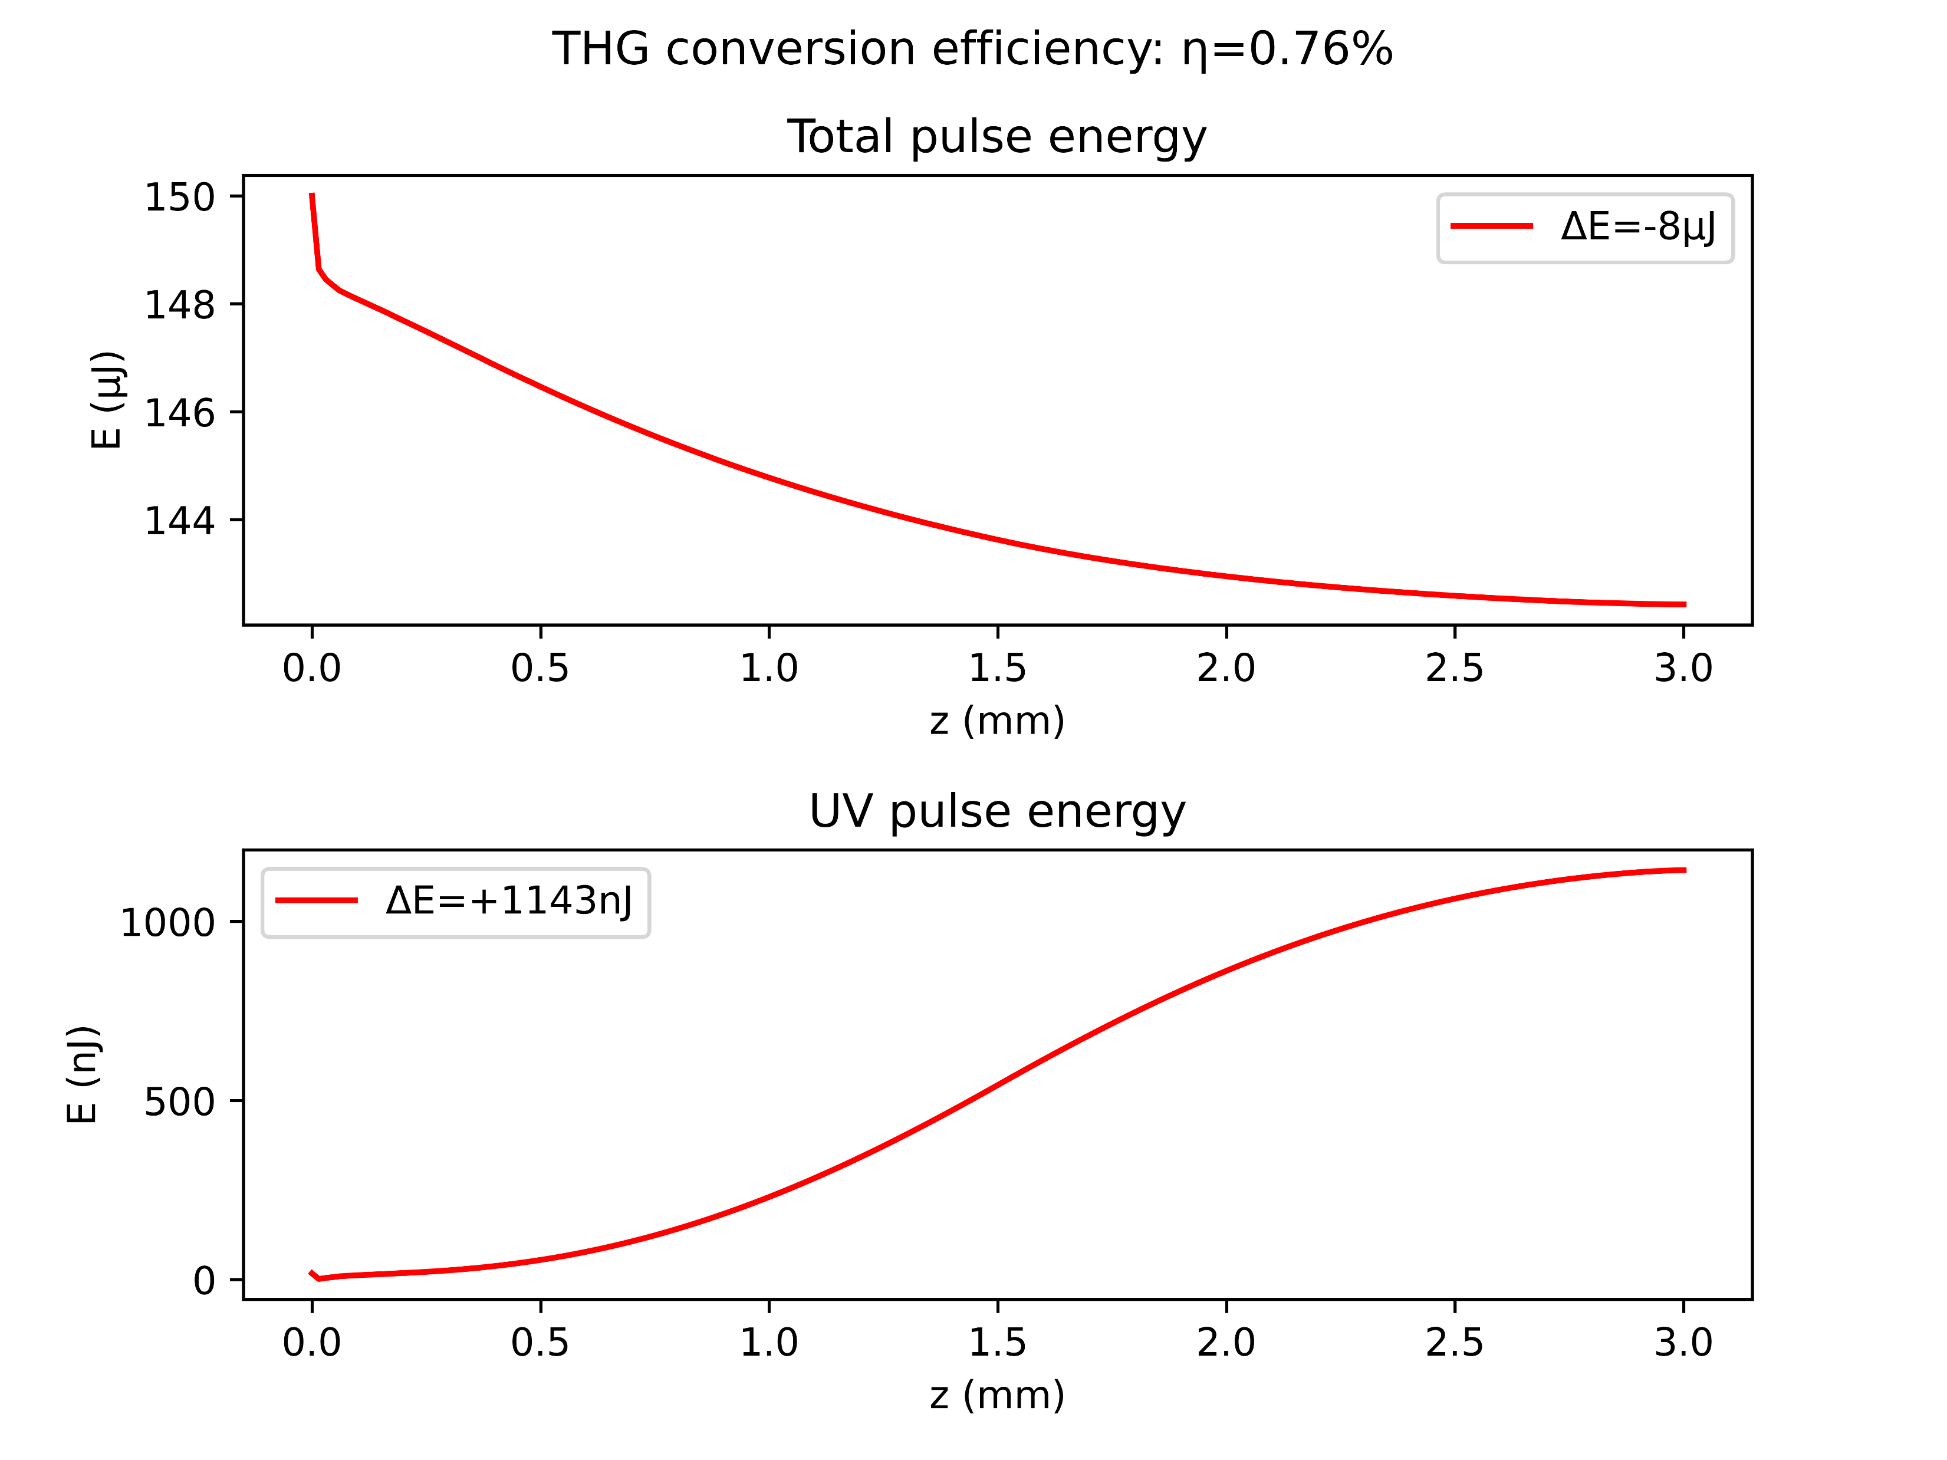
Case study: Argon at 1.0bar with 150mW
COMSOL
gradient

Slide 12
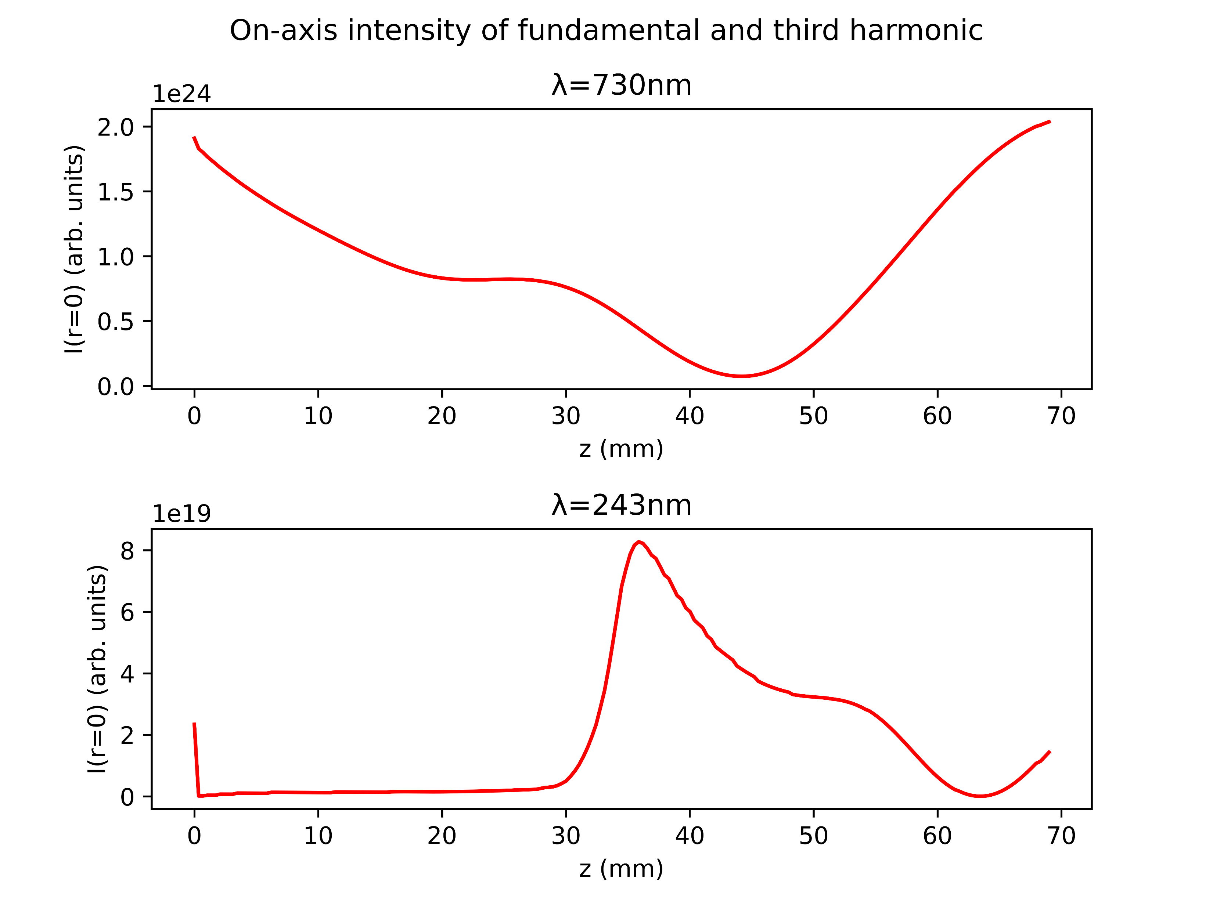
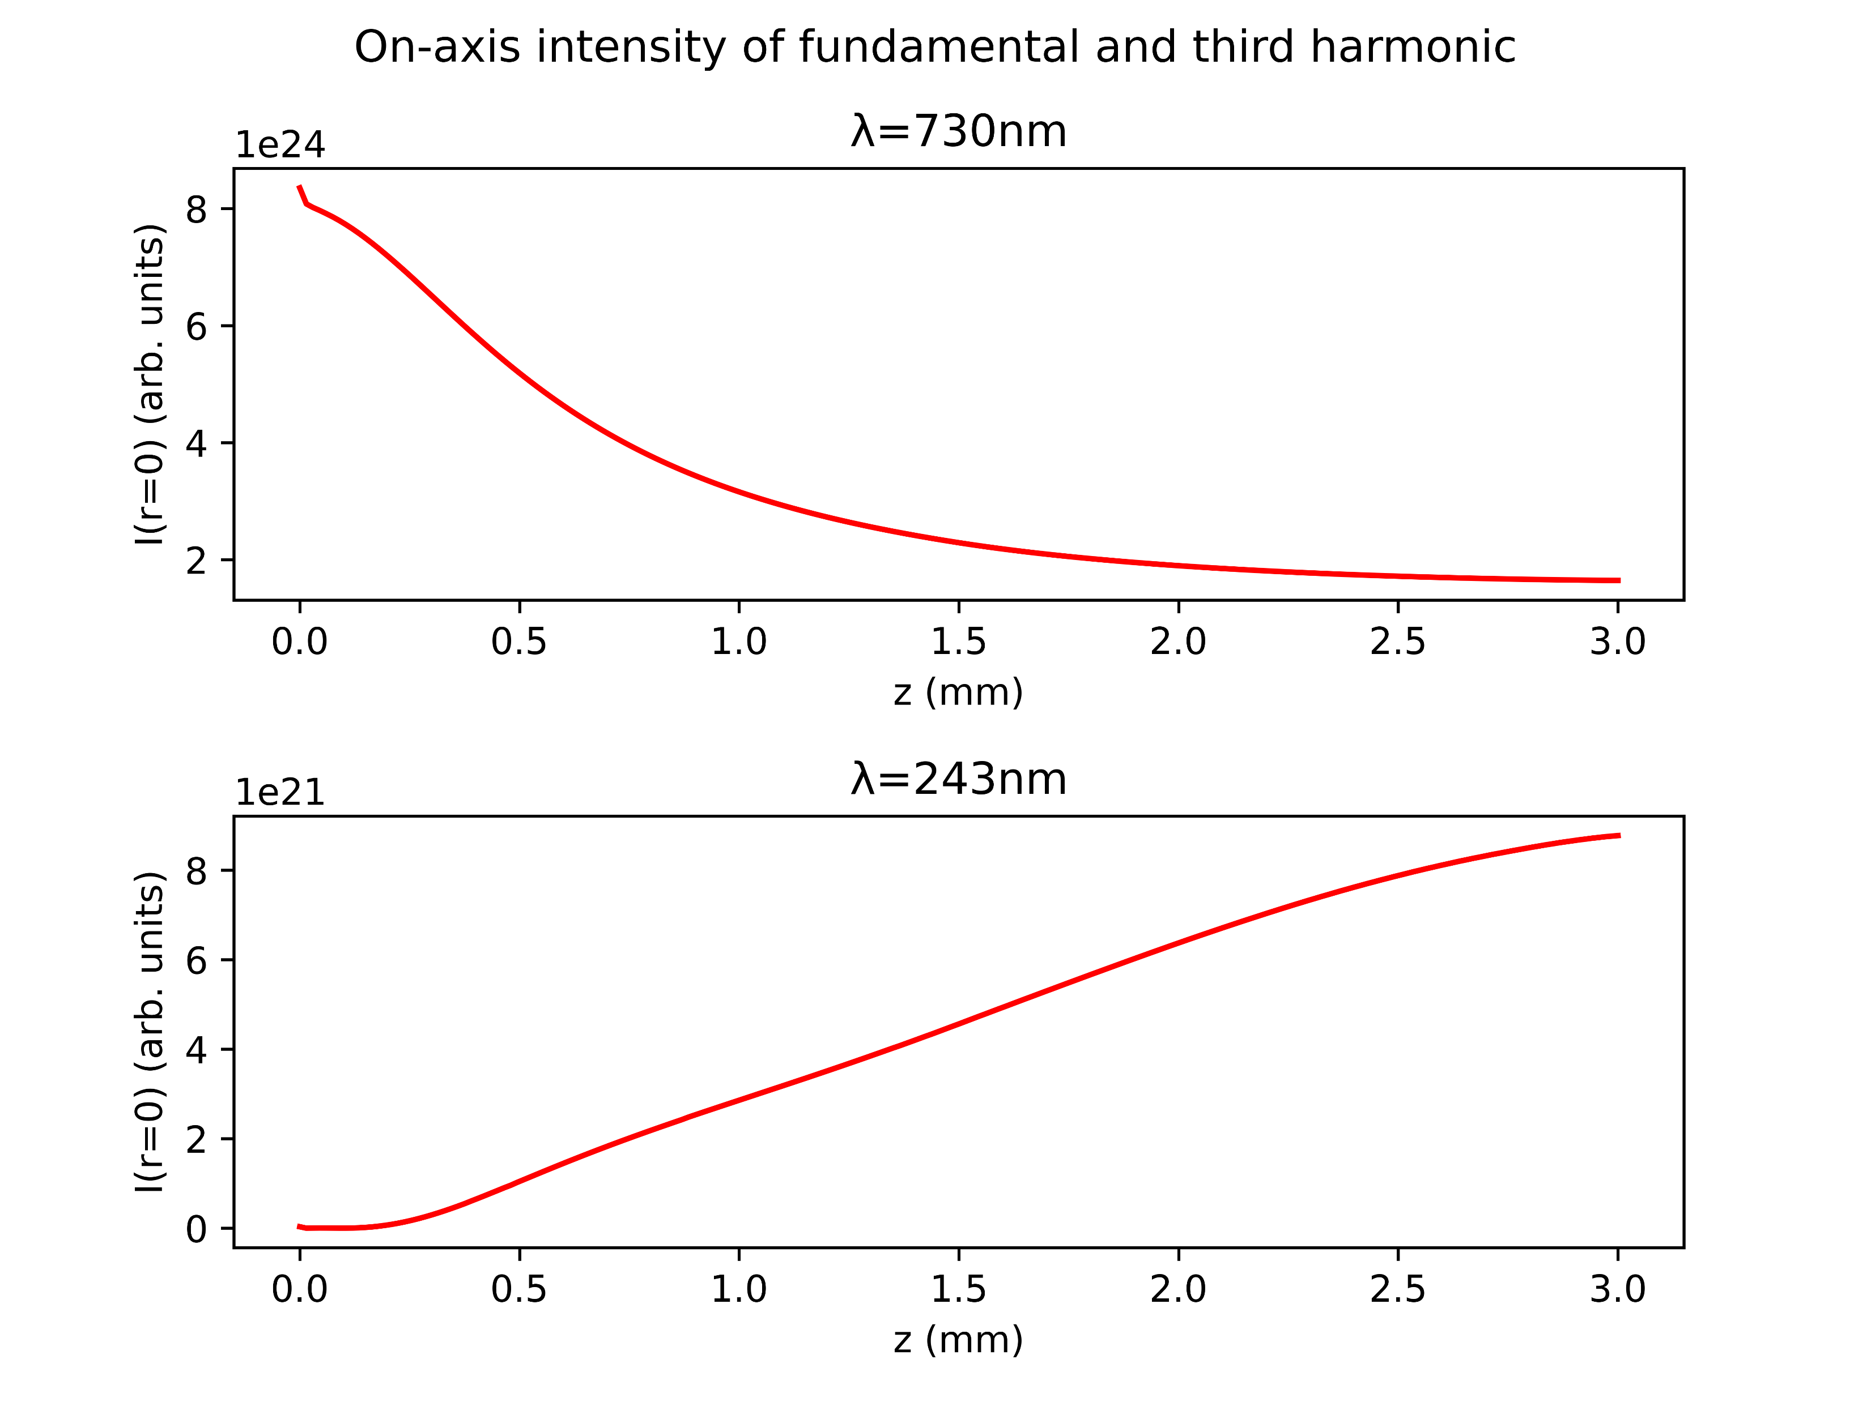
Case study: Argon at 1.0bar with 150mW
COMSOL
gradient

Slide 13
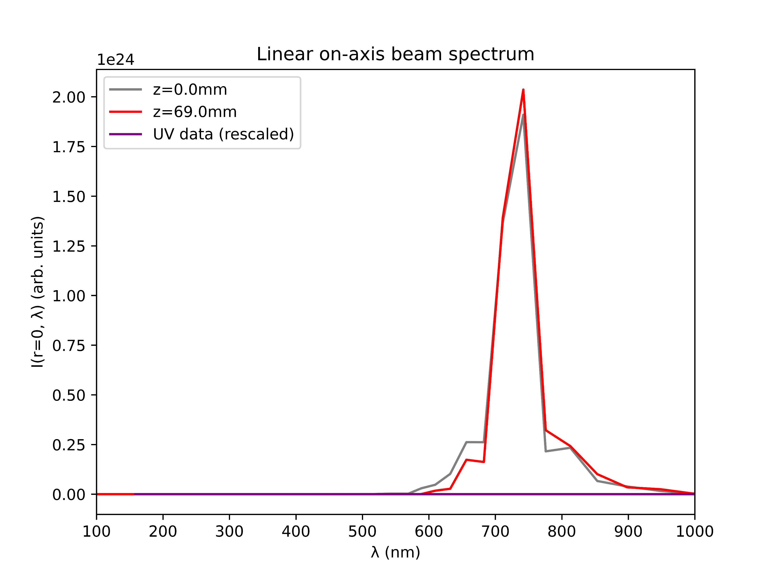
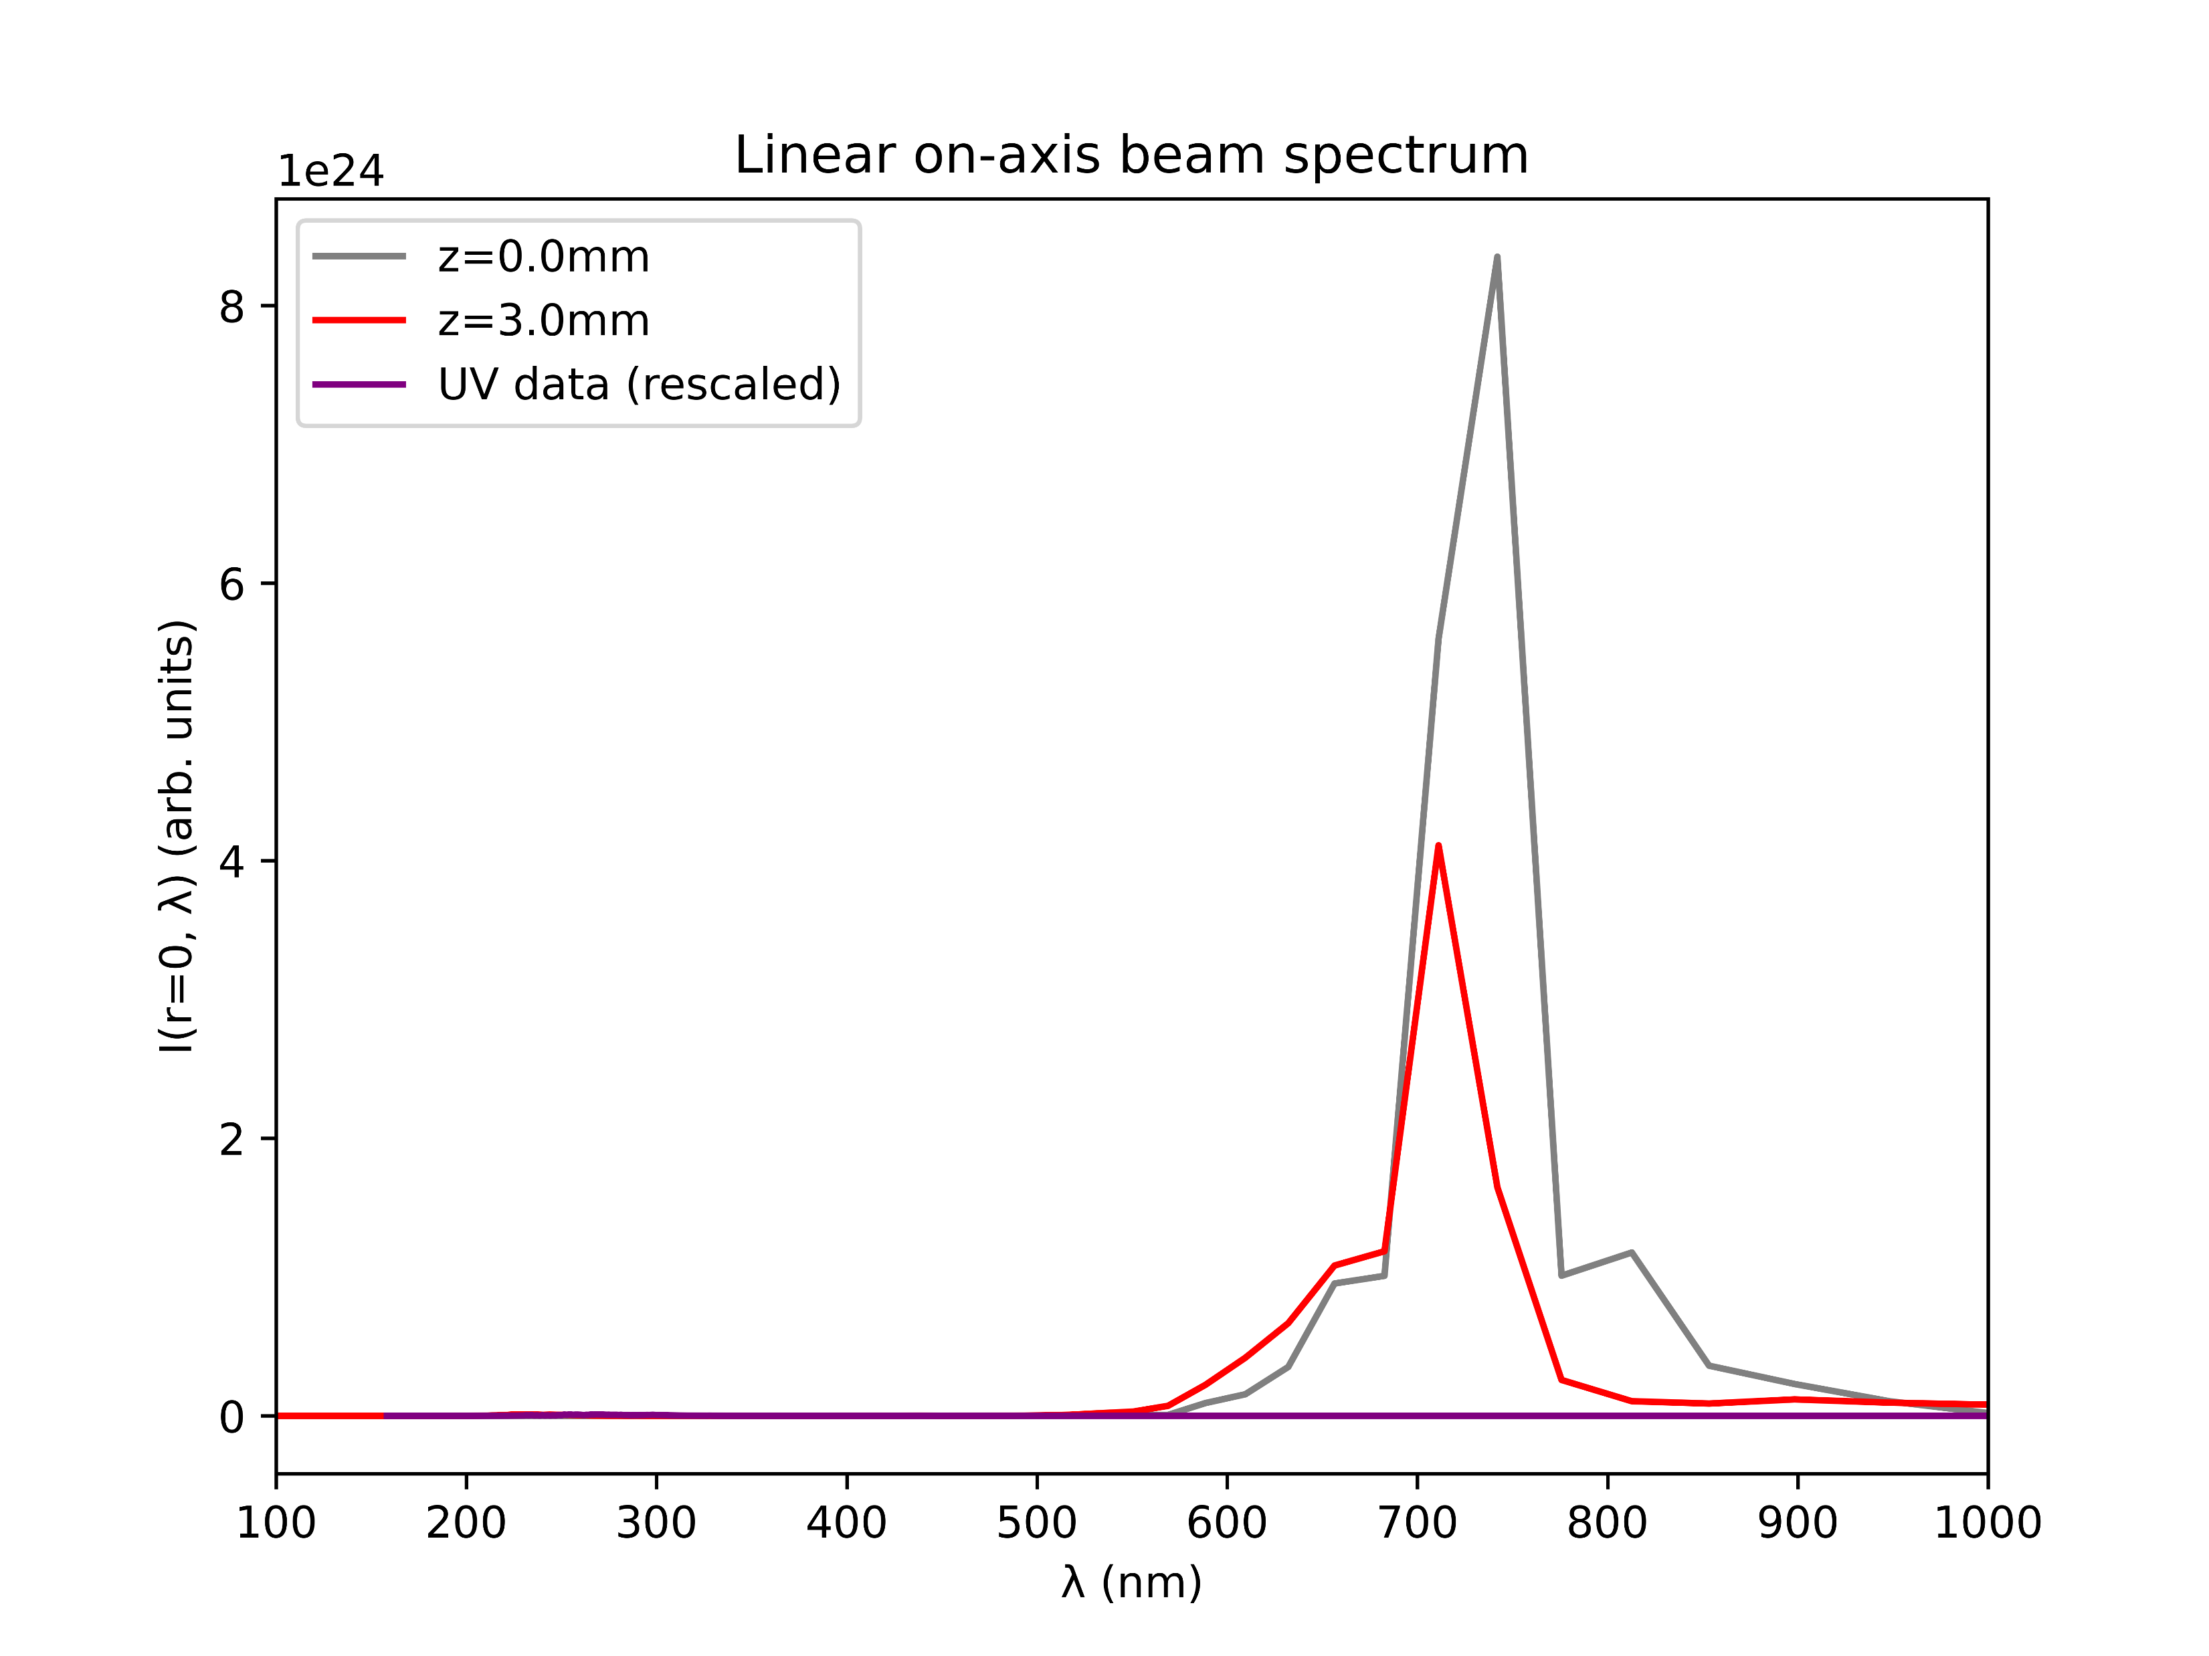
Case study: Argon at 1.0bar with 150mW
COMSOL
gradient

Slide 14
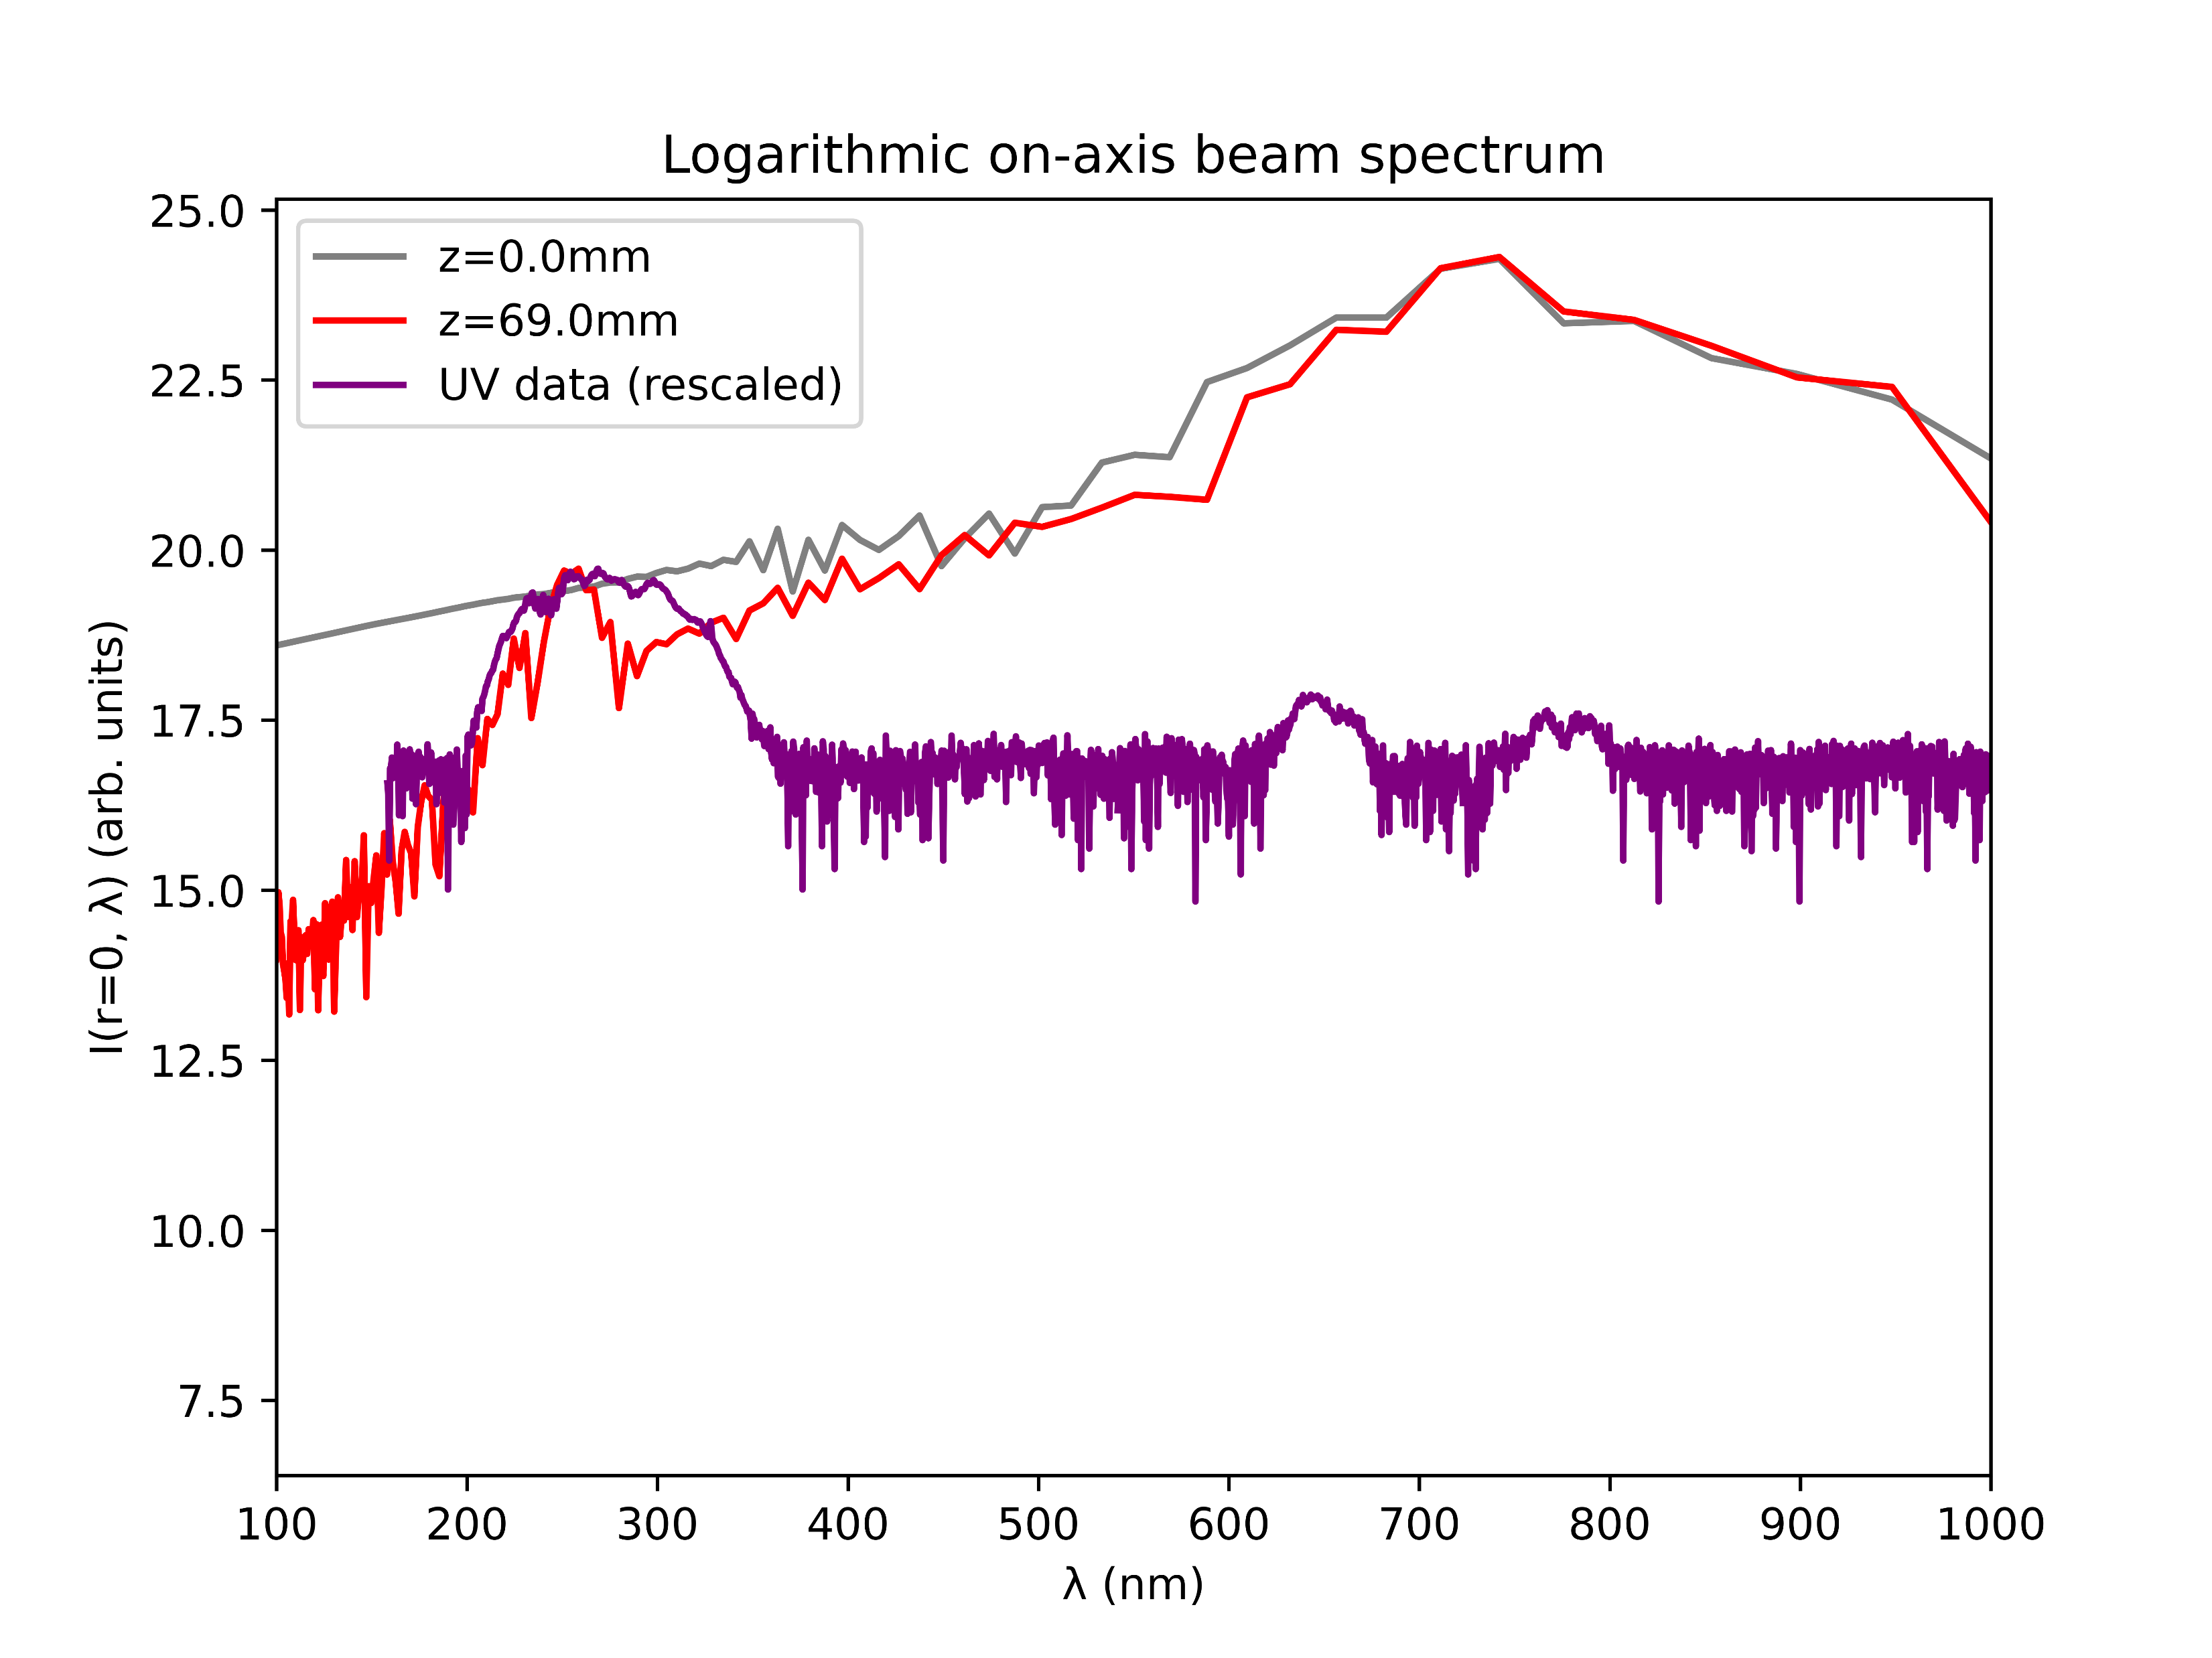
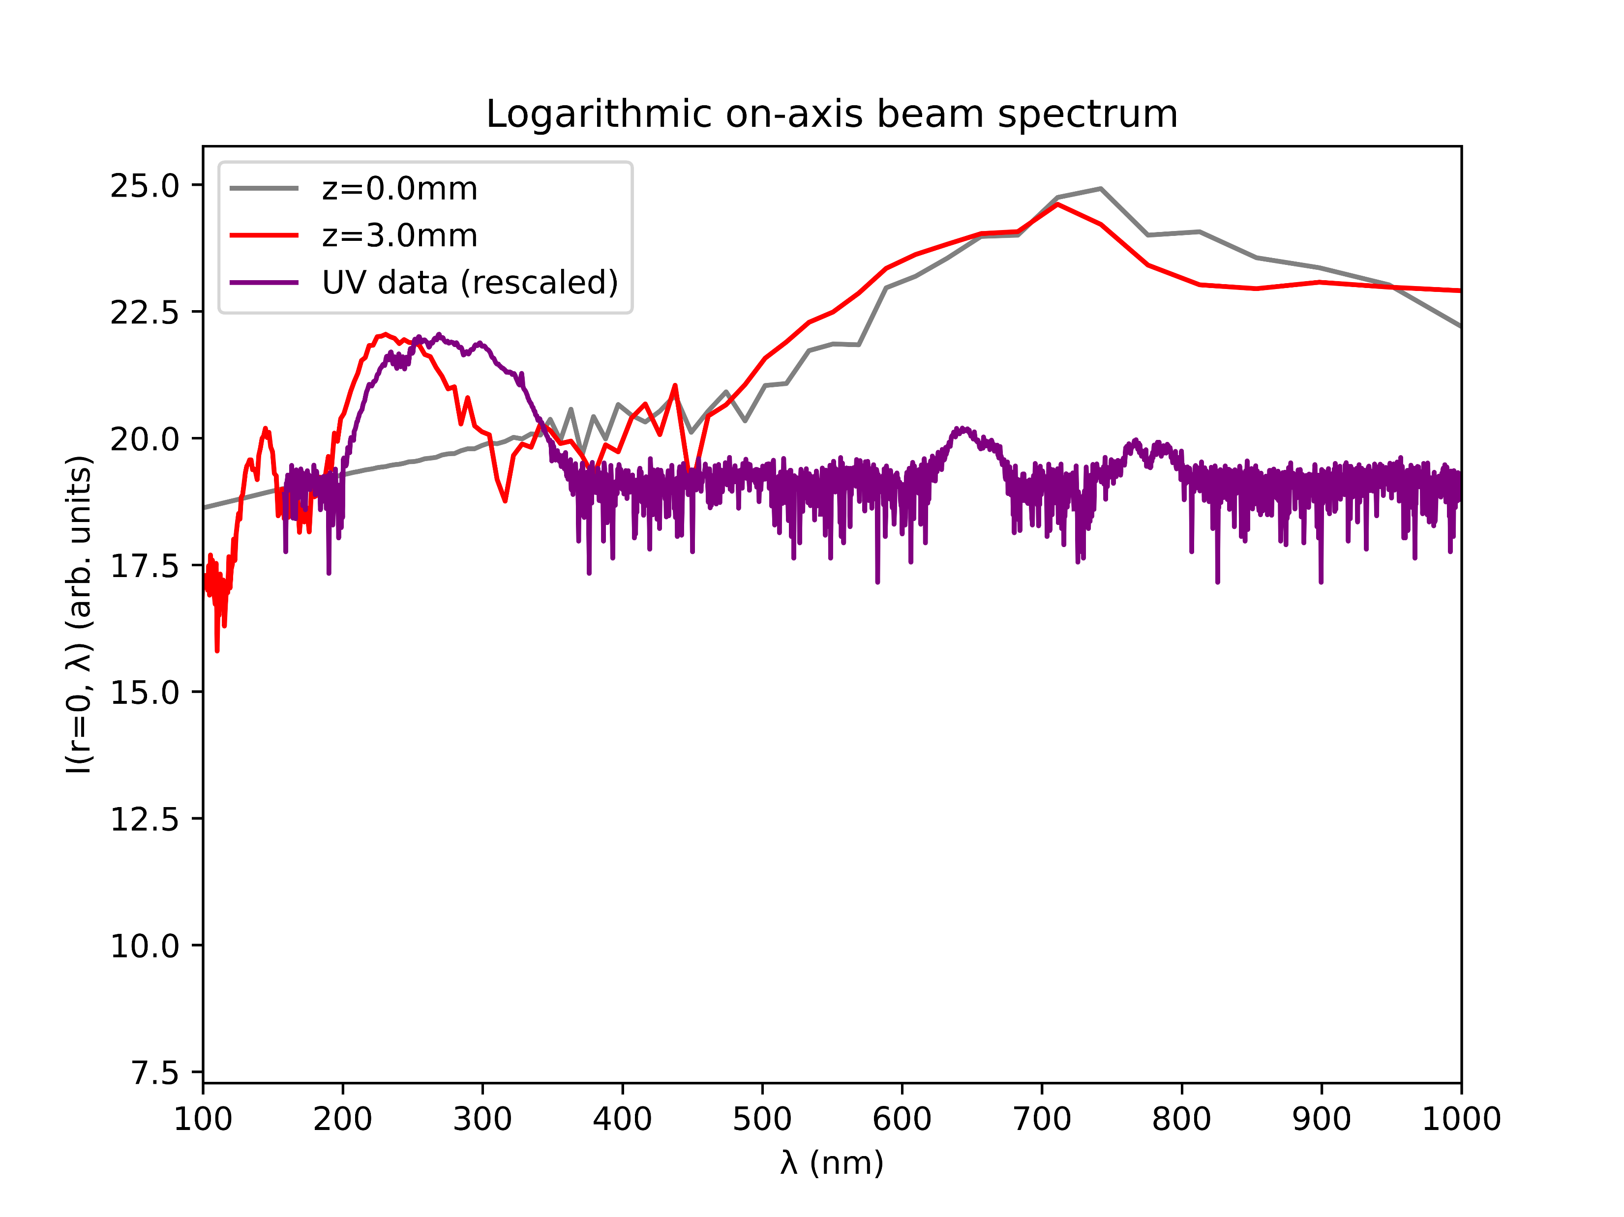
Case study: Argon at 1.0bar with 150mW
COMSOL
gradient

Slide 15
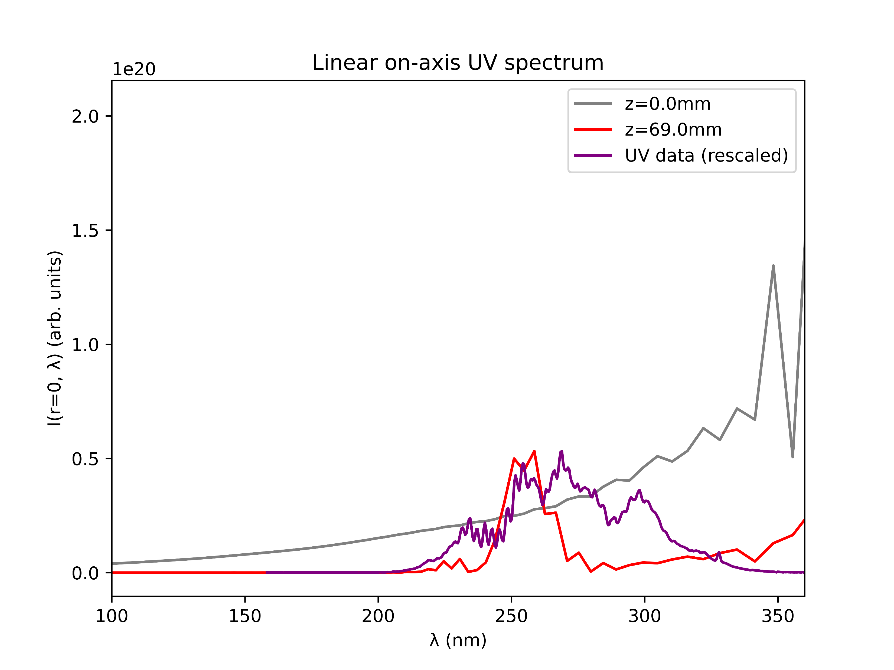
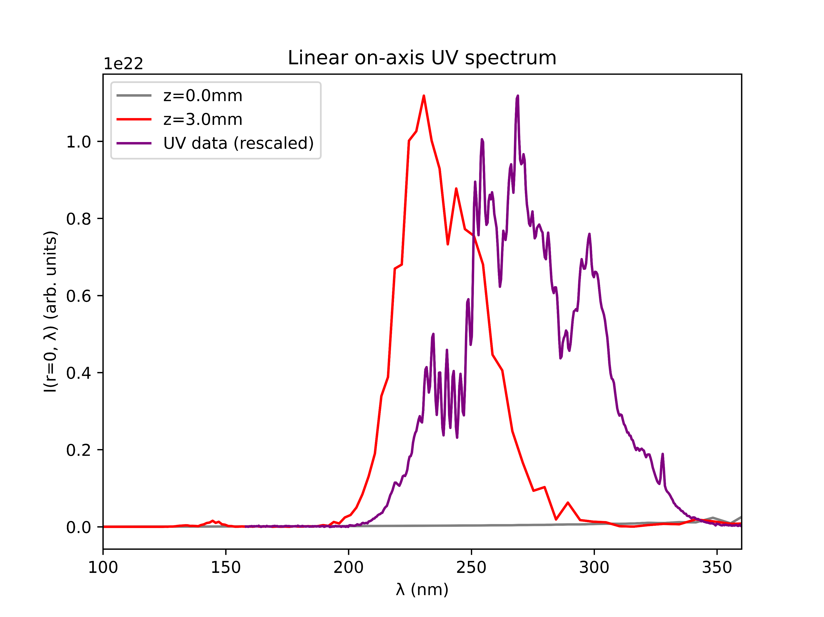
Case study: Argon at 1.0bar with 150mW
COMSOL
gradient

Slide 16
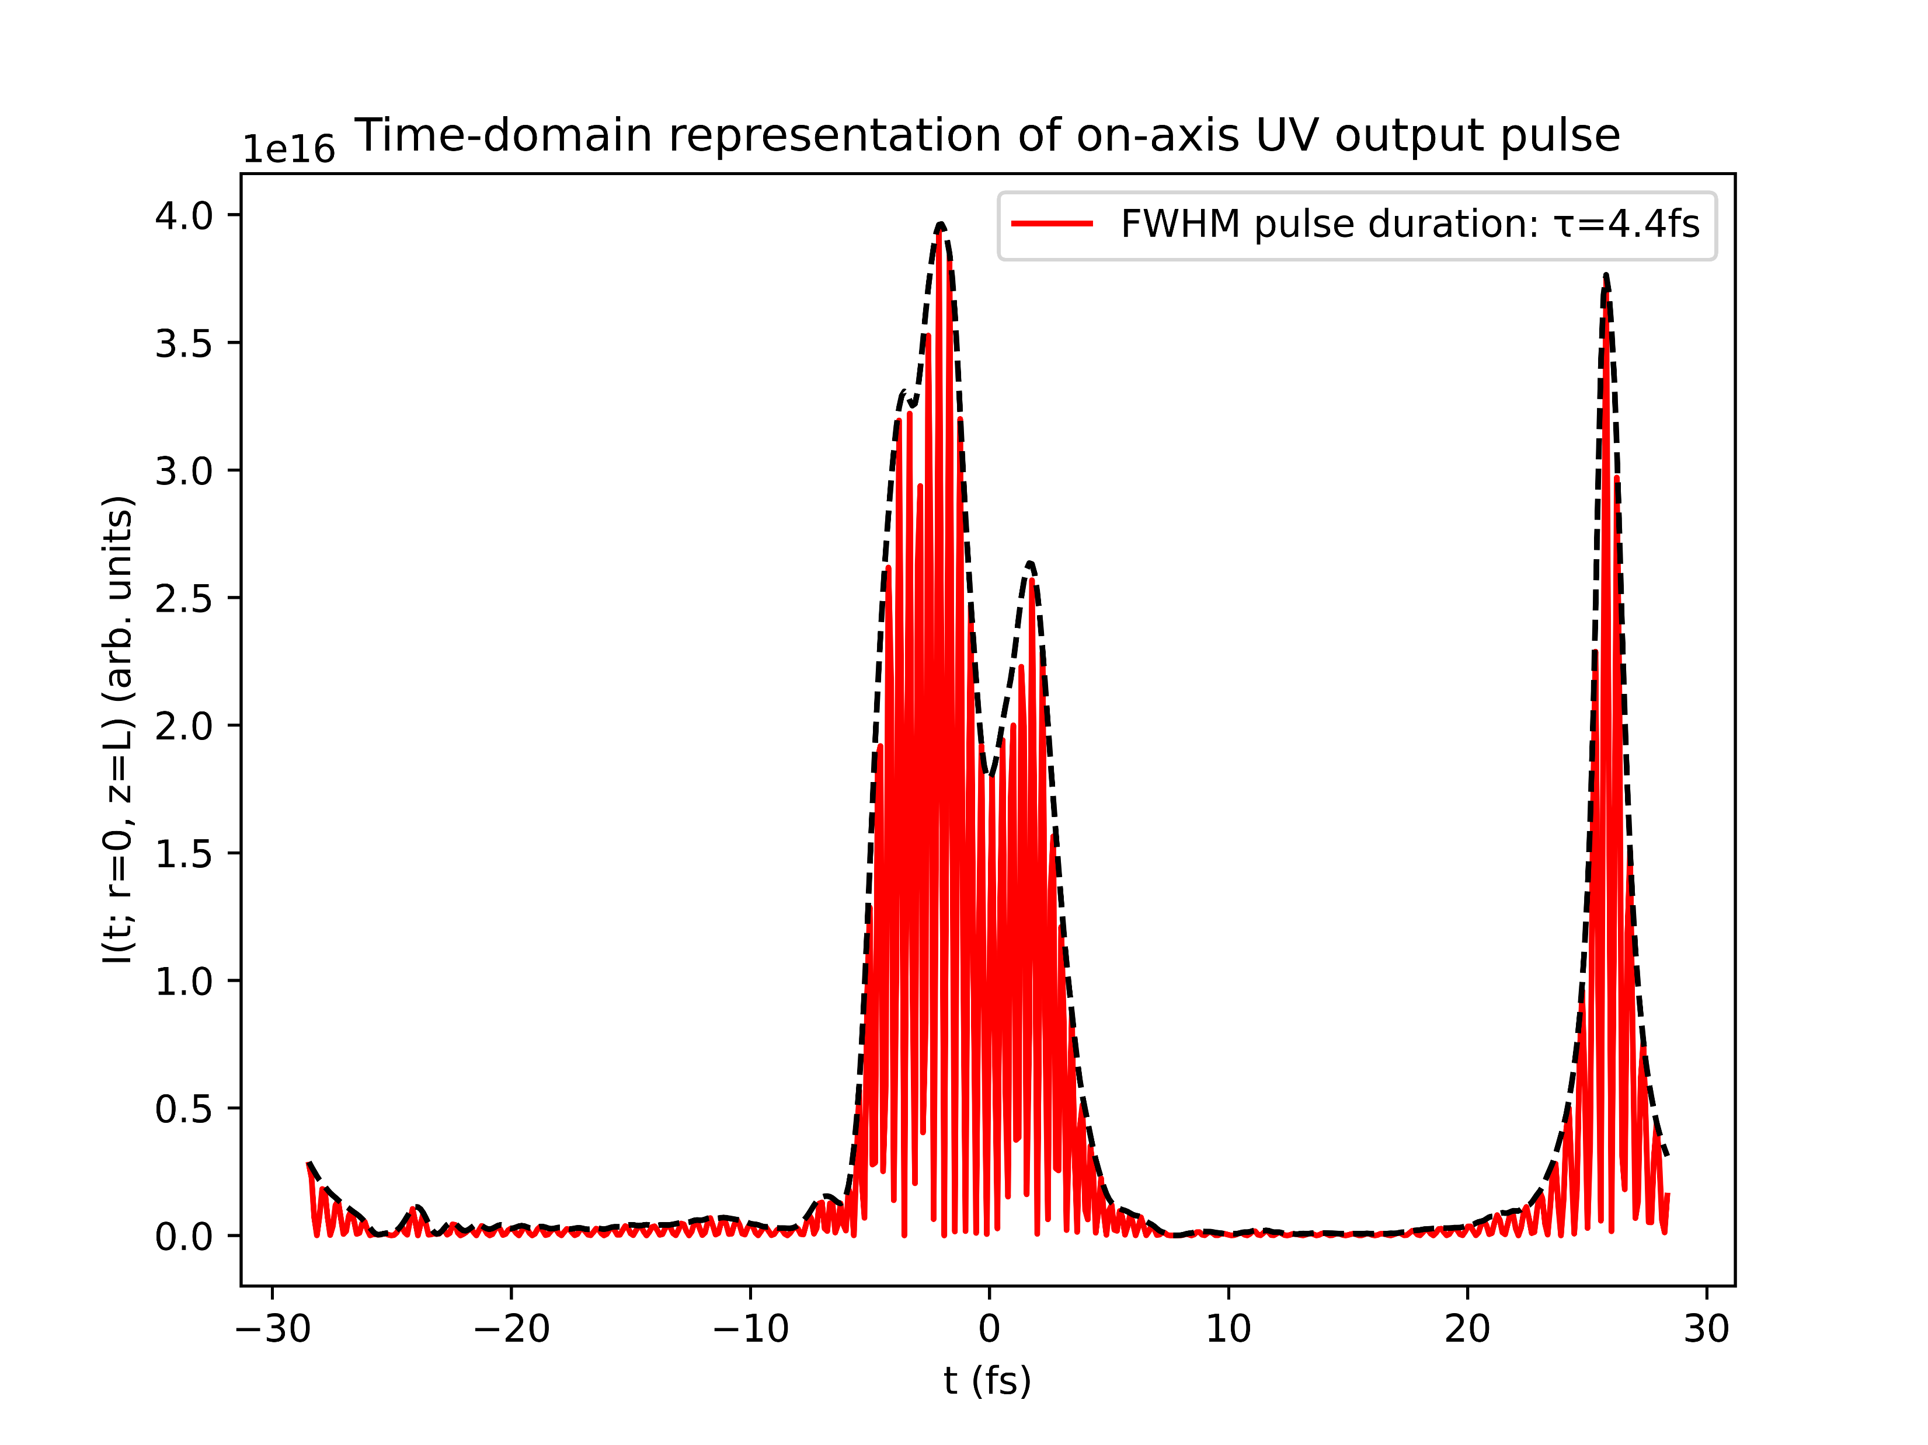
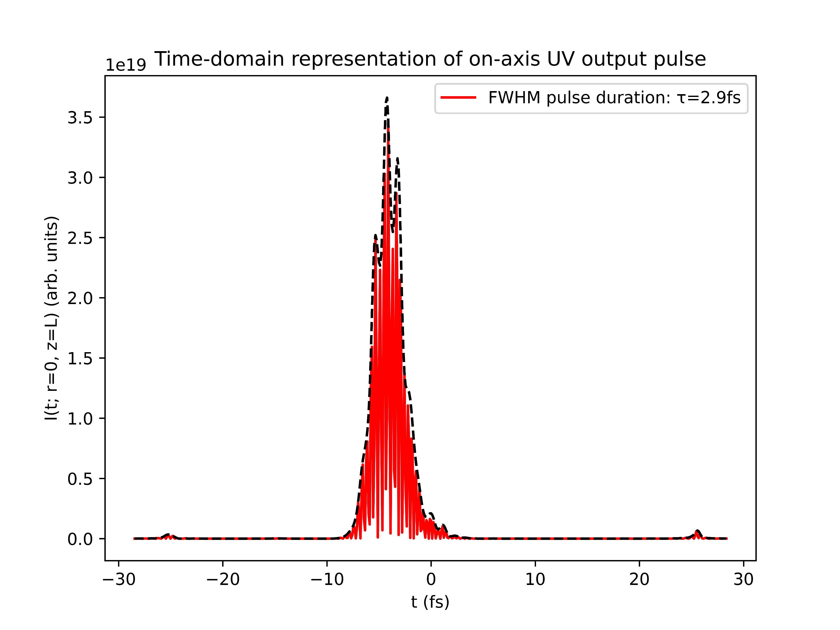
Case study: Argon at 1.0bar with 150mW
COMSOL
gradient

Slide 17
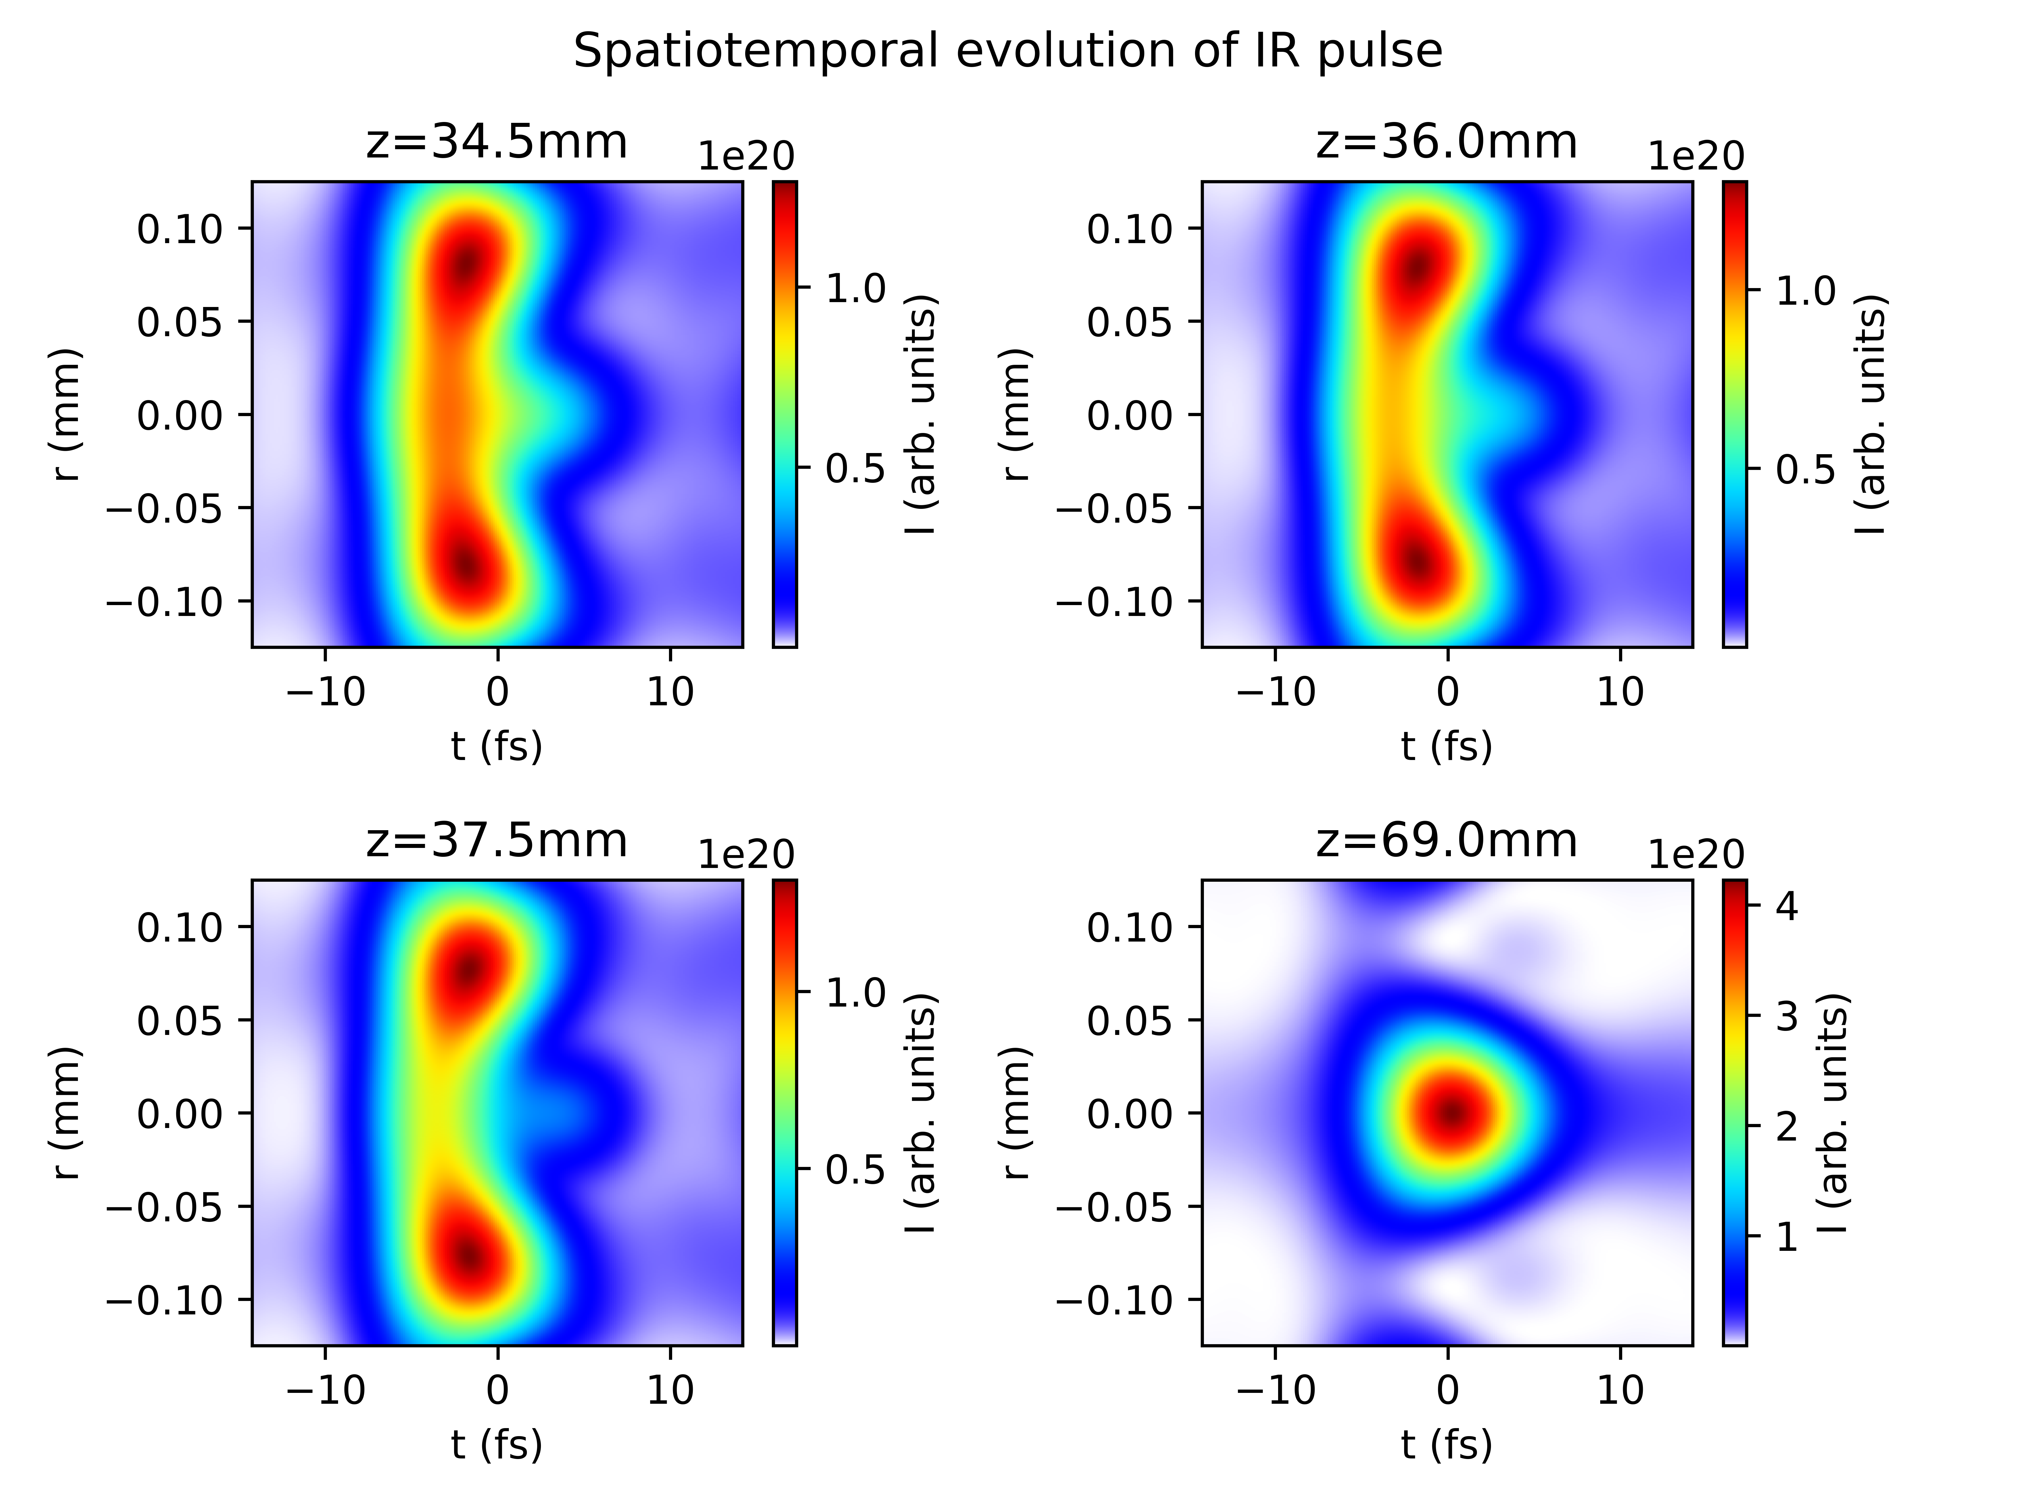
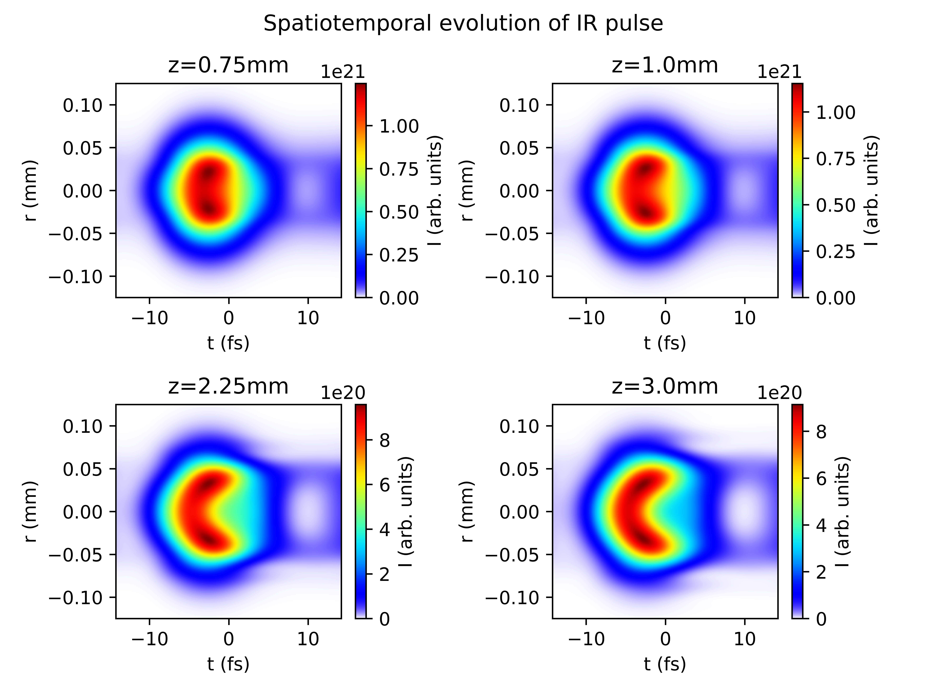
Case study: Argon at 1.0bar with 150mW
COMSOL
gradient

Slide 18
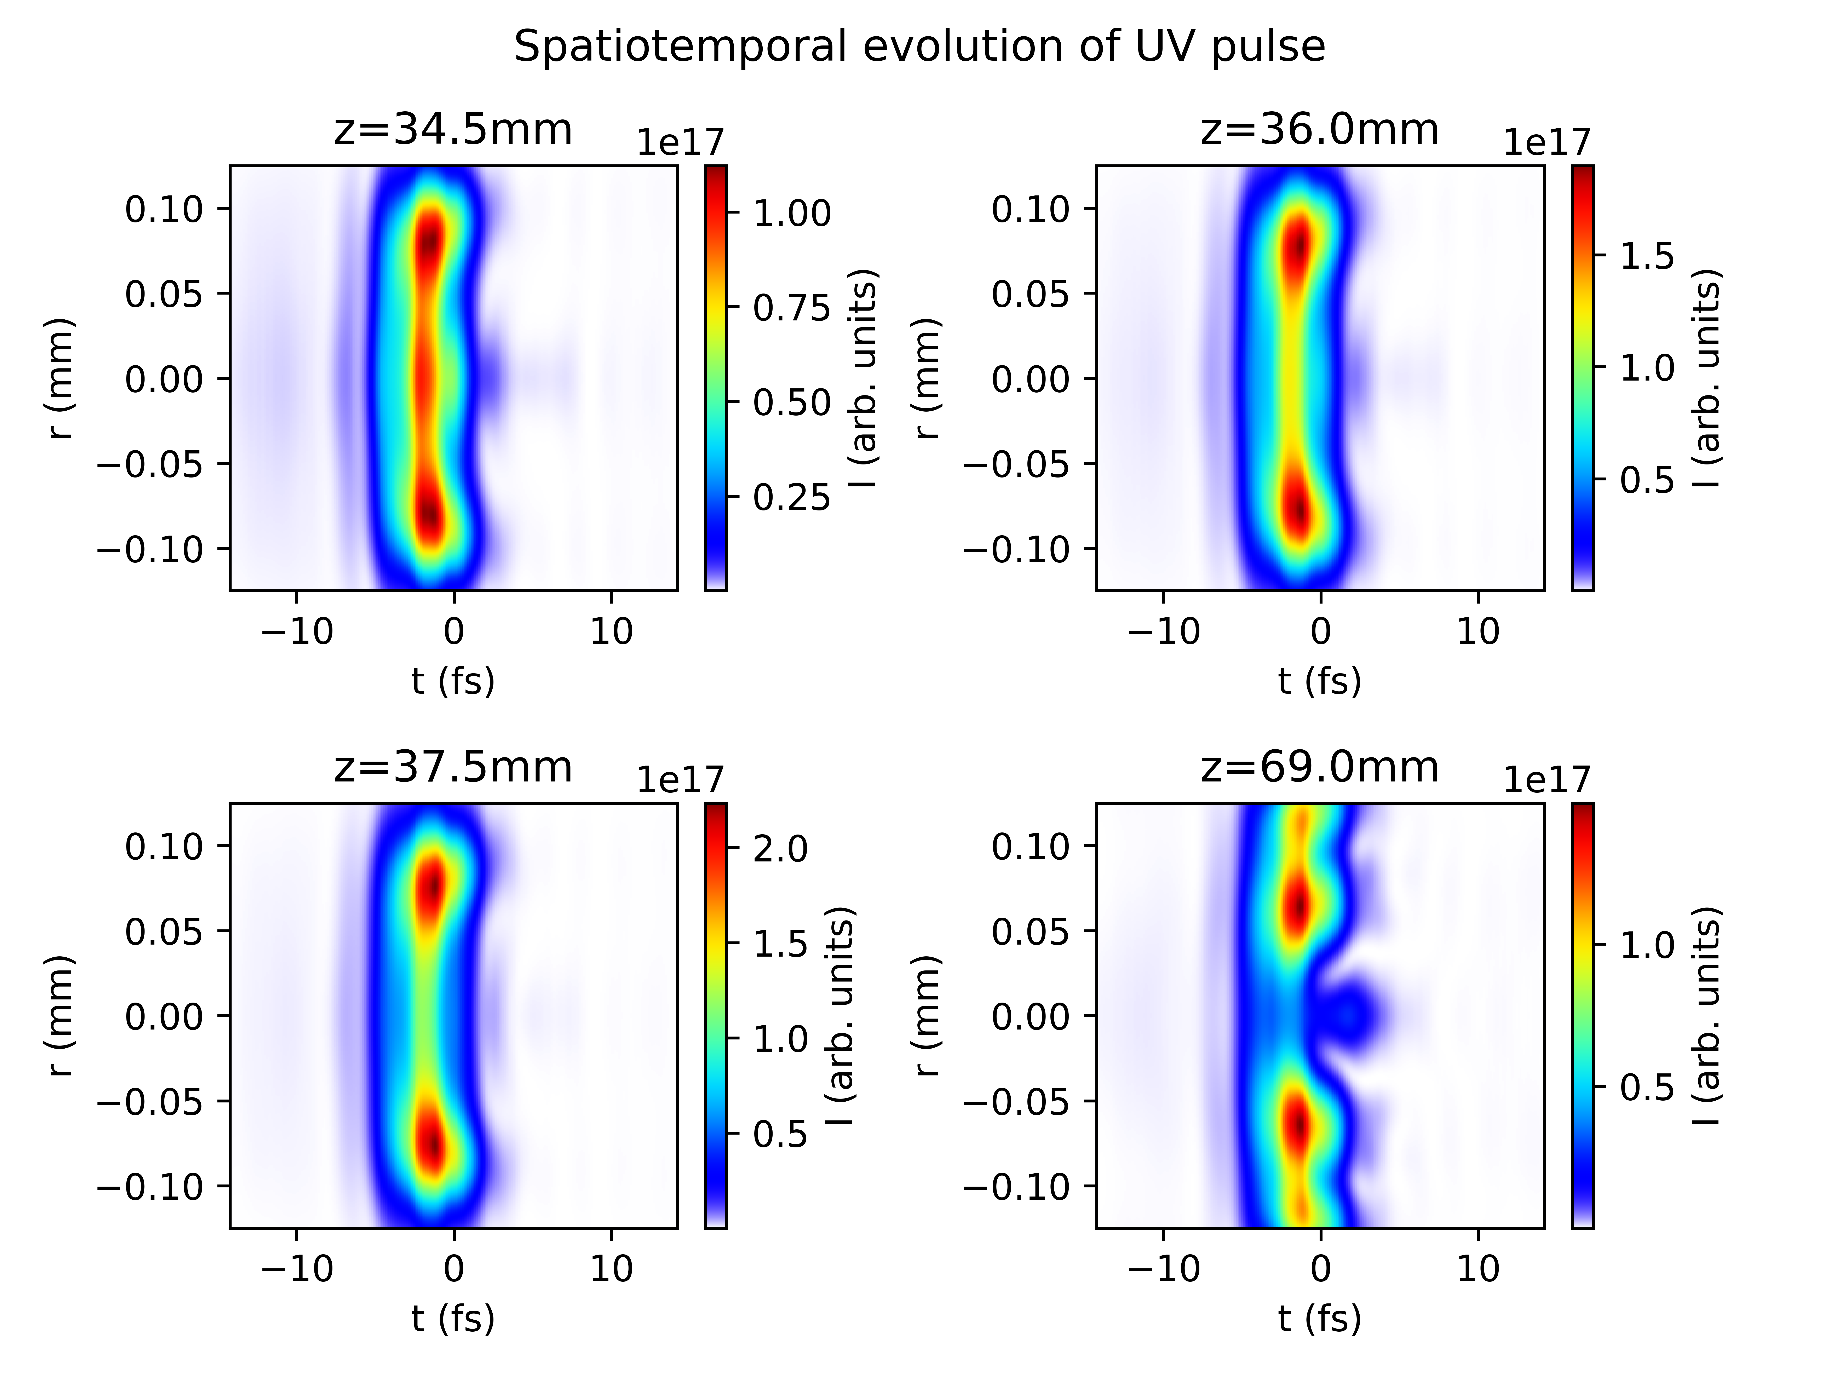
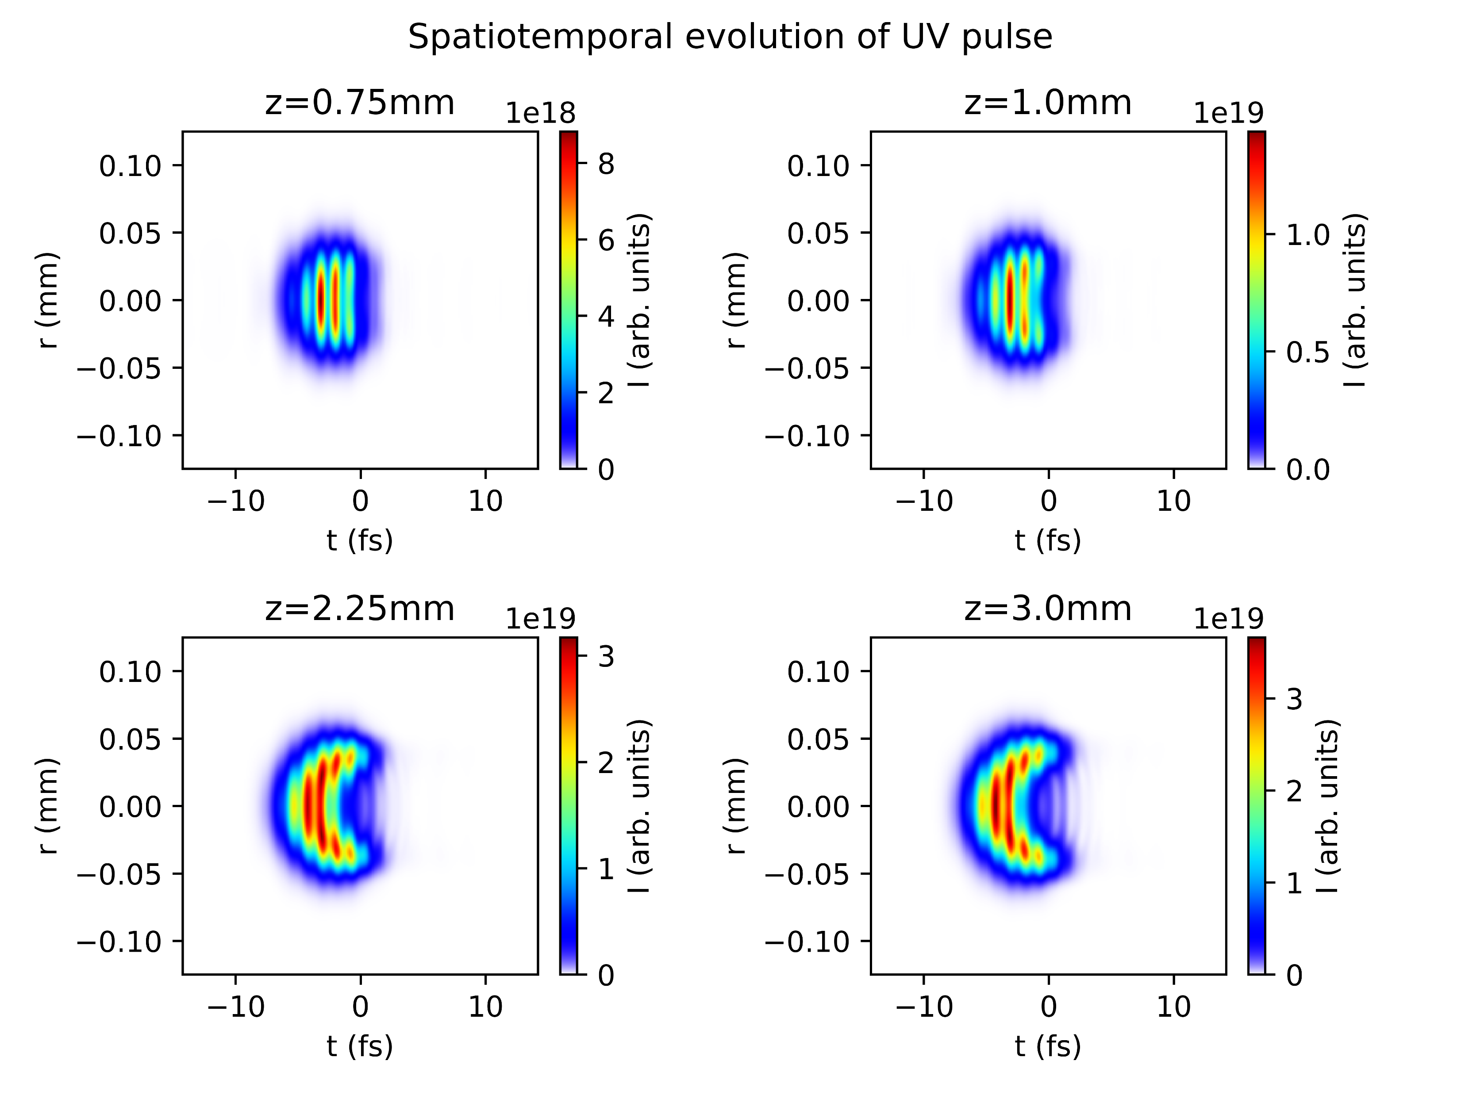
Case study: Argon at 1.0bar with 150mW
COMSOL
gradient

Slide 19
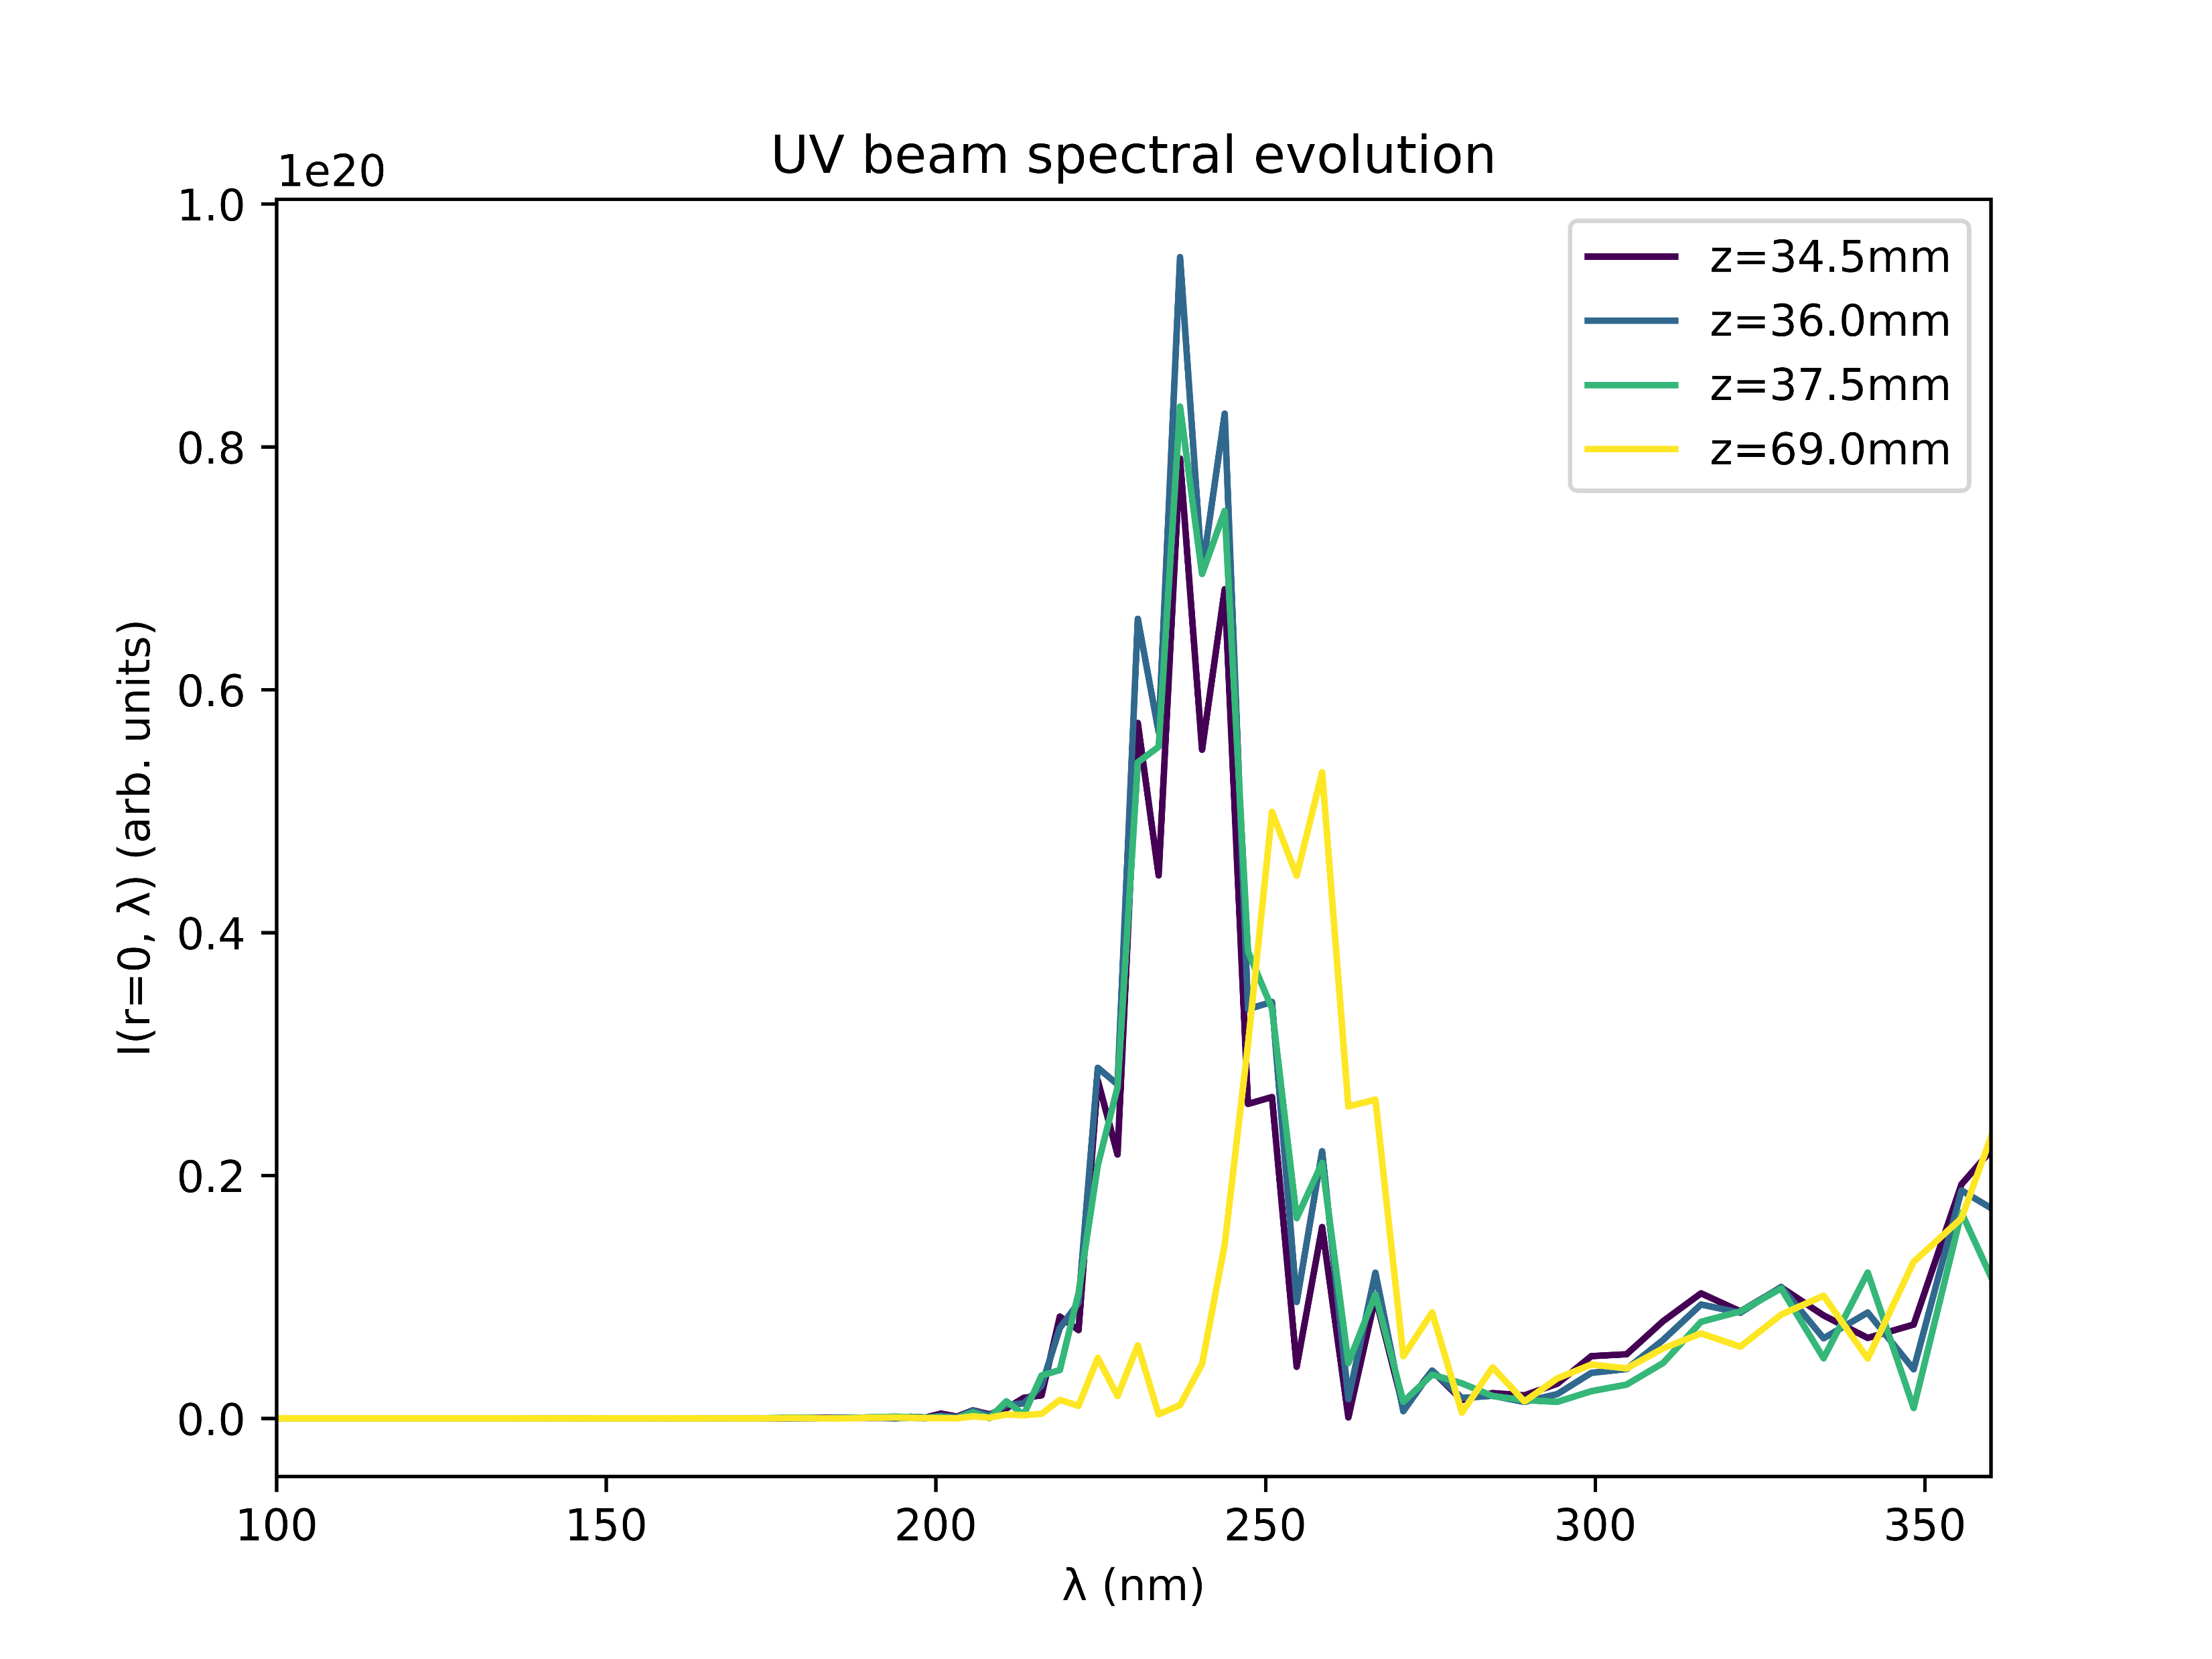
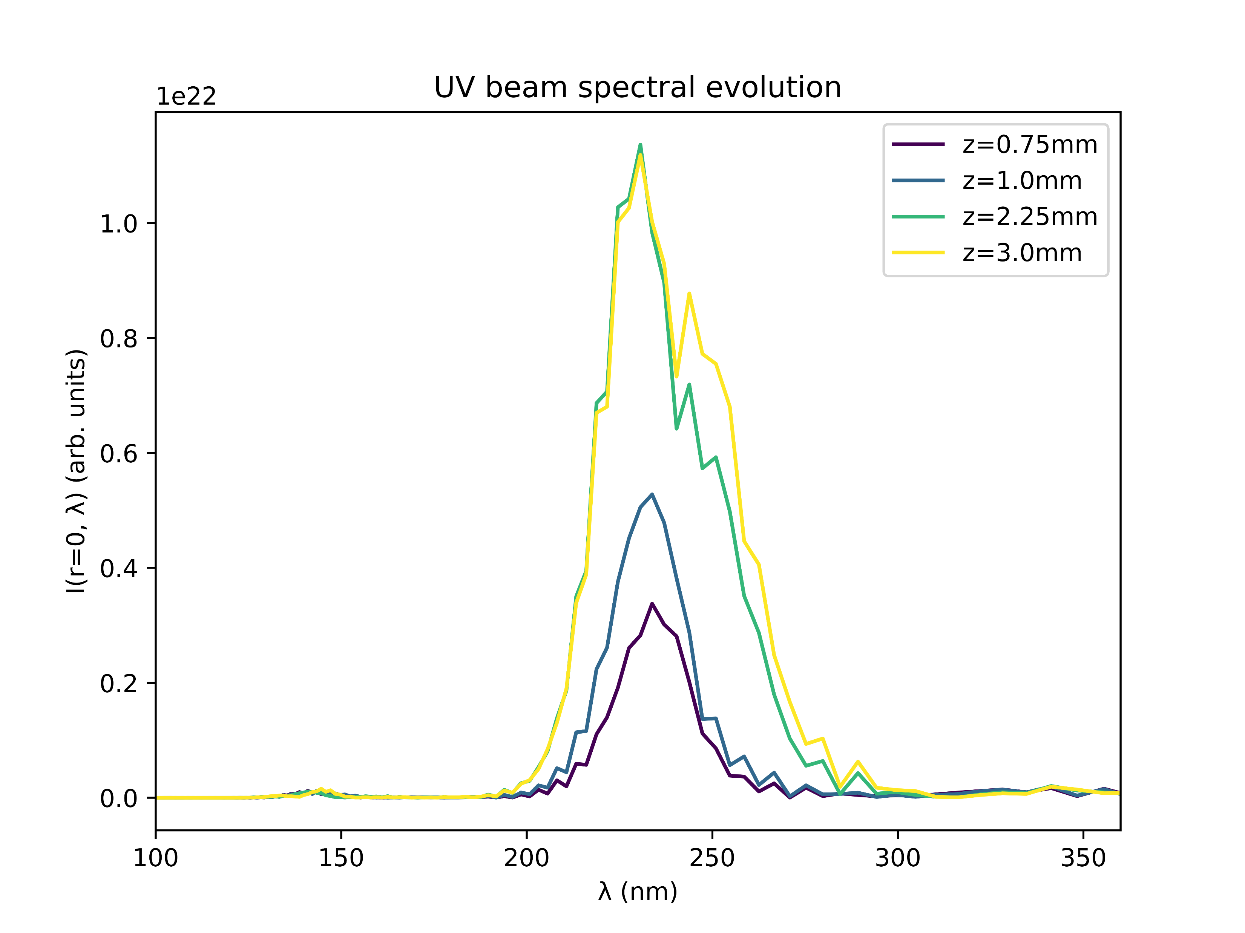
Case study: Argon at 1.0bar with 150mW
COMSOL
gradient

Slide 20
Conclusions
Despite the relatively good agreement of the gradient and COMSOL models within the cell, the simulation output is drastically different
Apart from the scale of the UV output energy, the gradient model seems to produce results that agree more closely with the expected and measured pulse properties
The relevant factor appears to be the propagation of the pulse outside the cell, which is neglected in the gradient model
Compare gradient model to a truncated COMSOL model involving only the cell itself?
Investigate propagation of the pulse before and after the cell?

Slide 21
II. GAS COMPARISONS

Slide 23
III. CONDITIONS OF INTEREST

Slide 24
Conditions of interest
The following table shows parameter combinations which are predicted to result in energetic (>100nJ) and short (sub-2fs) UV pulses
Gas | Beam power | Pressure | Density model | Pred. duration | Pred. energy
Ne | 400mW | 0.1-2.5bar | grad | 0.5-0.8fs | 100-800nJ
He | 400mW | 2.0-4.0bar | grad | 0.8fs | 500-1500nJ
Ar | 300mW | 2.5-4.0bar | grad | 1.1-1.5fs | 800-1000nJ
Xe | 300mW | 1.5-2.5bar | COMSOL | 0.7-1.1fs | 500-700nJ
He | 300mW | 2.0-5.0bar | grad | 0.6-1.0fs | 300-1400nJ
Ar | 300mW | 3.5-4.0bar | grad | 1.2fs | 800nJ
Ne | 300mW | 1.0-5.0bar | grad | 0.7-1.0fs | 500-2500nJ
N2 | 200mW | 3.0-5.0bar | grad | 1.5-1.9fs | 400-450nJ

Slide 25
Conditions of interest (cont.)
The following table shows parameter combinations which are predicted to result in energetic (>100nJ) and short (sub-2fs) UV pulses
Gas | Beam power | Pressure | Density model | Pred. duration | Pred. energy
N2O | 200mW | 3.5-5.0bar | grad | 1.1-1.3fs | 700-900nJ
Kr | 200mW | 1.5-3.0bar | grad | 1.3-1.5fs | 500-600nJ
He | 200mW | 3.0-5.0bar | grad | 0.5-1.1fs | 200-450nJ
Xe | 150mW | 0.8-2.0bar | grad | 1.5-1.9fs | 300-500nJ
N2O | 150mW | 3.5-5.0bar | grad | 0.8-1.3fs | 600-800nJ
Kr | 150mW | 1.5-2.5bar | grad | 1.3-1.5fs | 400-500nJ
He | 150mW | 4.5-5.0bar | grad | 1.1-1.2fs | 130-200nJ
N2 | 150mW | 4.0-5.0bar | grad | 1.6-1.9fs | 400-450nJ
Ne | 150mW | 2.1-5.0bar | grad | 0.7-1.1fs | 150-500nJ

Slide 26
IV. NEXT STEPS

Slide 27
Next steps?
Chirp!
Investigate conditions of interest in more detail?
Run more scans? [corrected with PPT?]
Investigate effect of pulse propagation outside the cell?

Slide 28
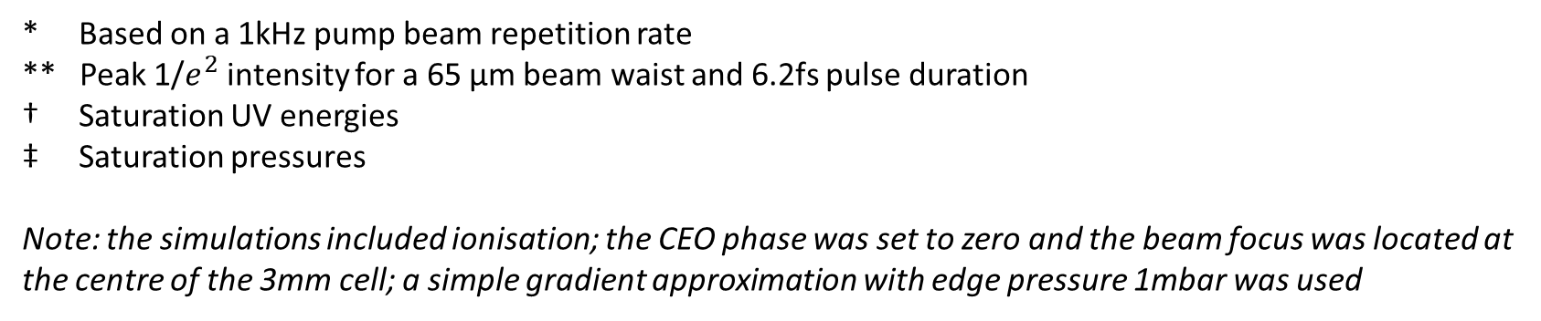
Relative Neon/Argon saturation values [OLD]
Beam power* | Beam peak intensity** | E_Ne/E_Ar † | P_Ne/P_Ar ‡
75mW | 0.091 PW/cm^2 | 0.945 | 11.591
150mW | 0.182 PW/cm^2 | 2.302 | 11.588
200mW | 0.243 PW/cm^2 | 2.871 | 10.688
300mW | 0.365 PW/cm^2 | 3.376 | 10.143
* Based on a 1kHz pump beam repetition rate
** Peak 1/$e^{2}$ intensity for a 65 µm beam waist and 6.2fs pulse duration
† Saturation UV energies
‡ Saturation pressures
Note: the simulations included ionisation; the CEO phase was set to zero and the beam focus was located at the centre of the 3mm cell; a simple gradient approximation with edge pressure 1mbar was used

Slide 29
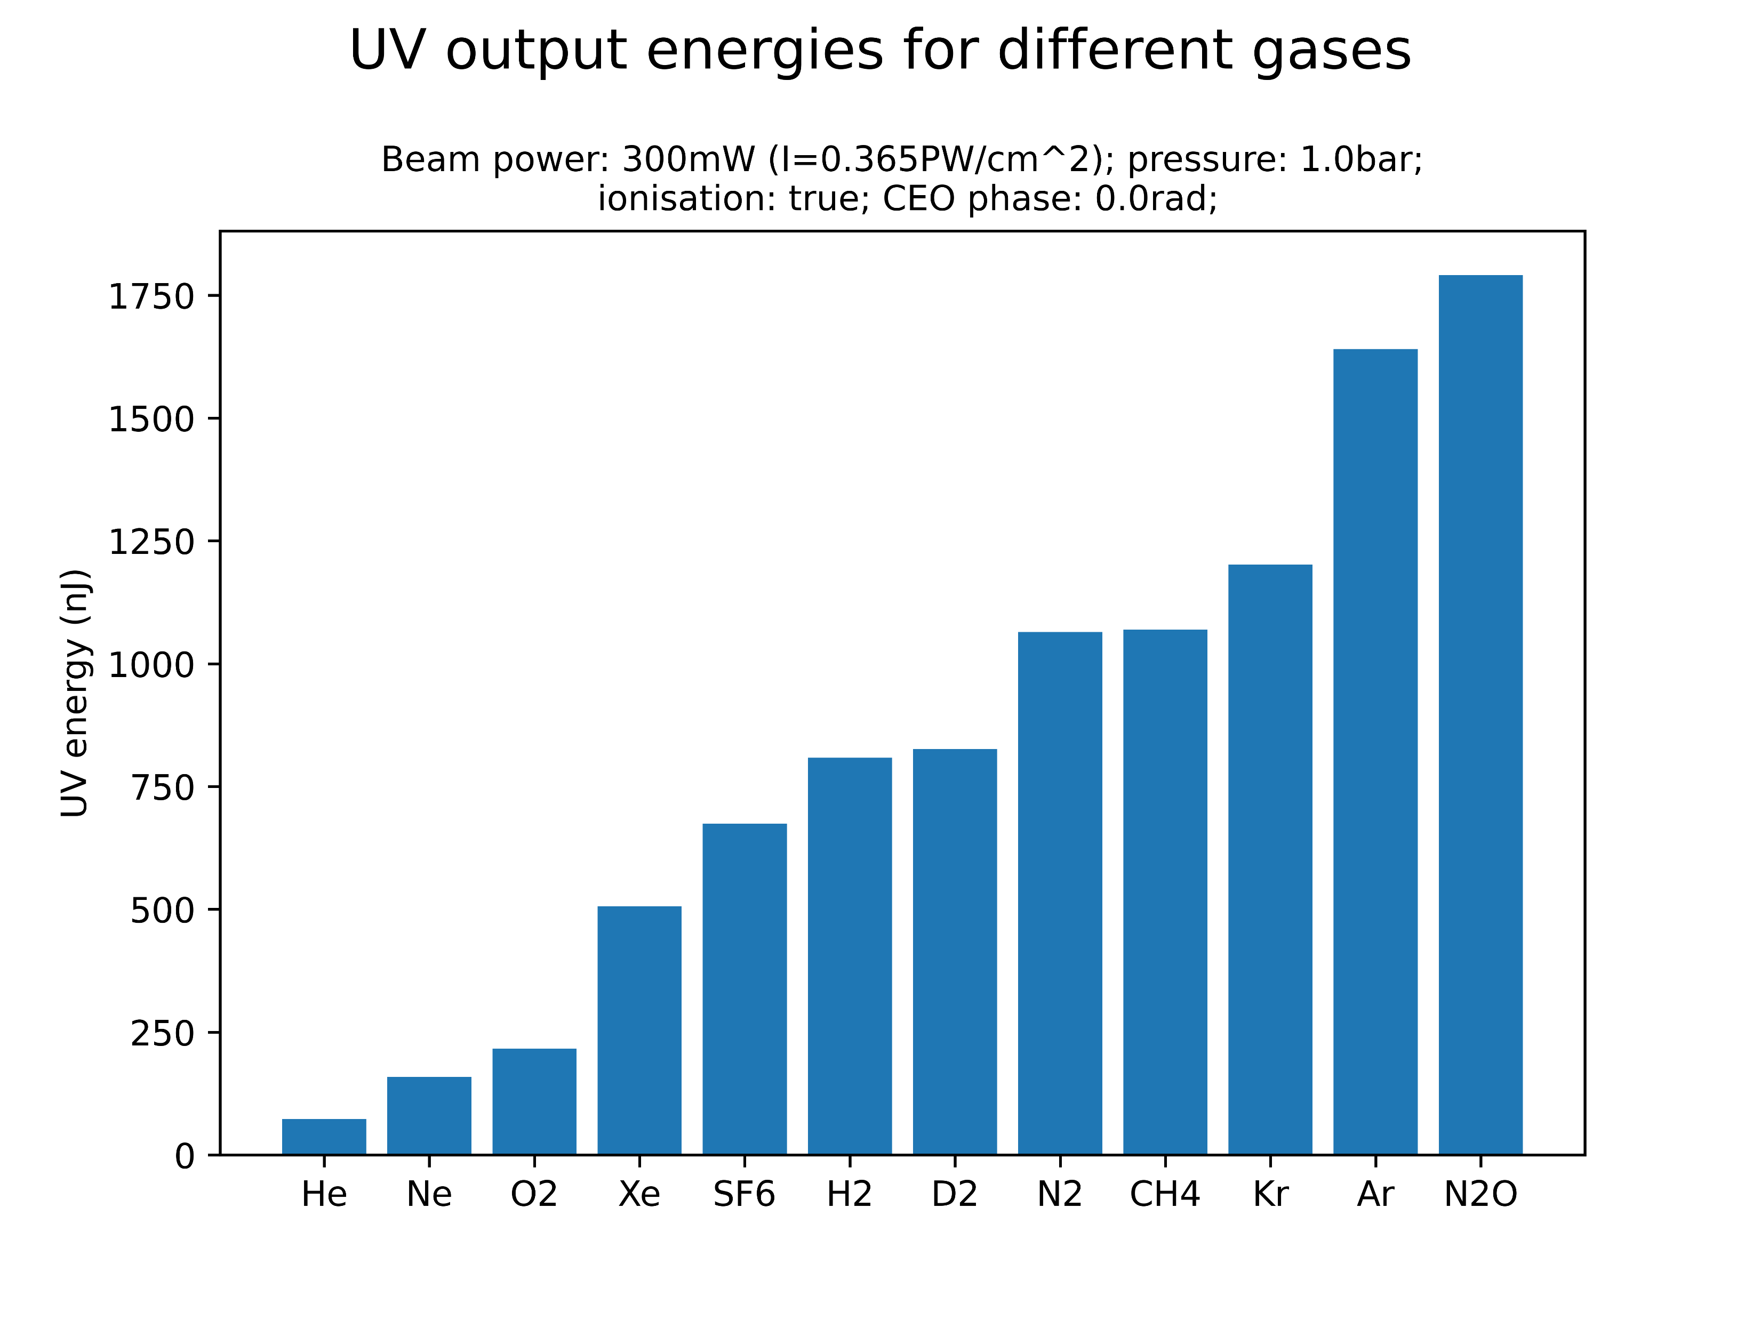
Comparison of different gases [OLD]
At the given parameter values, the highest UV energies are generated by krypton, argon and nitrous oxide
Investigate Kr and N2O in more detail (plots on Sync&Share)?
Neon, on the other hand, yields the second-lowest UV energy
Note that relative gas performance is likely sensitive to central gas pressure and beam power: simulations should be extended!

